Slide 1
Simulation Semantics,
Embodied Construction Grammar, and the Language of Actions and Events
Jerome Feldman
feldman@icsi.berkeley.edu

Slide 2
Integrated Cognitive Science
Neurobiology
Psychology
Computer Science
Linguistics
Philosophy
Social Sciences
Experience
Take all the Findings and Constraints Seriously

Slide 3
Embodiment
Of all of these fields, the learning of languages would be the most impressive, since it is the most human of these activities. This field, however, seems to depend rather too much on the sense organs and locomotion to be feasible.
Alan Turing (Intelligent Machines,1948)
< Continuity Principle of Darwin, American Pragmatists >

Slide 4
Neural Theory of Language: NTL
NTL’s main tenets
  direct neural realization, and
  continuity of thought and language, evolution
    both of which entail a commitment to parallel processing and spreading activation
  importance of language communities
    skeletal beliefs, grammars
  simulation semantics
    language understanding involves some of the brain circuitry involved in perception, motion, and emotion
    formalization of actions and events
  best-fit process
    underlies learning, understanding, and production

Slide 5
The ICSI/Berkeley
Neural Theory of Language Project
Principal investigators
  Jerome Feldman (UCB,ICSI)
  George Lakoff (UCB Ling)
  Srini Narayanan (Google, ICSI)
Affiliated faculty
  Eve Sweetser (UCB Ling)
  Rich Ivry (UCB Psych)
  Lisa Aziz-Zadeh (USC)
Graduate Students/Researchers
  Michael Ellsworth
  Luca Gilardi
  Ellen Dodge (ICSI)
  Sean Trott
  Steve Doubleday(UC Irvine)
Alumni
  Robert Porzel (U. Bremen)
  Terry Regier (UCB Ling, CogSci)
  Johno Bryant (Ask)
  Lokendra Shastri (Infosys)
  David Bailey (Google)
  Leon Barrett (Monsanto)
  Nancy Chang (Google)
  Ellen Dodge (ICSI)
  Joe Makin (UCSF)
  Eva Mok (Sweden)
  Andreas Stolcke (Microsoft)
  Dan Jurafsky (Stanford Ling)
  Olya Gurevich (Microsoft)
  Benjamin Bergen (UCSD)
  Carter Wendelken (UCB)
  Srini Narayanan (Google, UCB)
  Steve Sinha (US Govt.)
  Gloria Yang (U. Taiwan)

Slide 6
Objective
Converging evidence from neuroscience, psychology, neural computation, and cognitive linguistics leads us to hypothesize that understanding requires imaginative simulation.
  Simulation uses neural networks involved in perception, action, emotion, and social cognition.
  The meaning of abstract concepts relies on metaphoric projections from embodied circuits.
Provide an cognitively motivated operational computational framework of simulation semantics to investigate the interaction between language, action, and cognition.
Use simulation semantics in building systems for computing with natural language that come close to human performance levels. This is necessary for joint action in complex scenarios with a mix of human and artificial agents.

Slide 7
ECG - NLU Beyond the 1980s
Much more computation
NLP technology
Construction Grammar: form-meaning pairs
Conceptual compositionality + Idioms, etc.
4. Cognitive Linguistics: Conceptual primitives
ECG = Embodied Construction Grammar; 6 distinct uses of formalism
5. Constrained Best Fit : Analysis, Simulation, Learning
Analysis uses Bayesian (form, meaning and context) best fit
6. Under-specification: Meaning involves context, goals, etc.
SemSpec = Semantic/Simulation Specification
7. Simulation Semantics; Meaning as action/simulation
8. CPRM= Coordinated Probabilistic Relational Models; Petri Nets ++
Action formalism works as a generative model
9. Domain Semantics; Need rich semantics on the Action side
10. General NLU front end: Modest effort to link to a new Action side

Slide 8
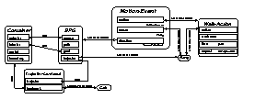
Language understanding: analysis & simulation
construction WALKED
form
self_{f}.phon ← [wakt]
meaning : Walk-Action
constraints
self_{m}.time before Context.speech-time
self_{m}..aspect ← encapsulated
“Harry walked into the cafe.
Utterance
Constructions
Lexicon
Analysis Process
General Knowledge
Semantic
Specification
Belief State
CAFE
Simulation

Slide 9
ECG - NLU Beyond the 1980s
Much more computation
NLP technology
Construction Grammar: form-meaning pairs
Conceptual compositionality + Idioms, etc.
4. Cognitive Linguistics: Conceptual primitives
ECG = Embodied Construction Grammar; 6 distinct uses of formalism
5. Constrained Best Fit : Analysis, Simulation, Learning
Analysis uses Bayesian (form, meaning and context) best fit
6. Under-specification: Meaning involves context, goals, etc.
SemSpec = Semantic/Simulation Specification
7. Simulation Semantics; Meaning as action/simulation
8. CPRM= Coordinated Probabilistic Relational Models; Petri Nets ++
Action formalism works as a generative model
9. Domain Semantics; Need rich semantics on the Action side
10. General NLU front end: Modest effort to link to a new Action side

Slide 10
Active representations
Many inferences about actions derive from what we know about executing them
X-net representation based on stochastic Petri nets captures dynamic, parameterized nature of actions
Used for acting, recognition, planning, and language
walker at goal
  Walking: bound to a specific walker with a direction or goal
  consumes resources (e.g., energy)
  may have termination condition
  (e.g., walker at goal)
  ongoing, iterative action
energy
walker=Harry
goal=home
Notes:
Certain words are closely associated with biological phenomena.
Simple representation based on petri nets.
Action/event representation has in common with motor control the need to refer to
process states and transitions;
and resource consumption/production; parameters.
Part of learning/understanding words like “push”, “walk” clearly involves grounded knowledge about how to perform the action, as well as quite complex/concrete inferences based on execution. (e.g....)
Note: these representations might be parameterized: “shove”, “walk slowly”, “walk home”
and NOTE: this model of action is accurate cross-linguistically, even if some specific conditions on word meaning varies from language to language.
This may seem complex, but in fact VERY early children seem to have no problem performing and understanding words like this. And more complicated ones too!

Slide 11
How do we specify an event? Formalized event schema
FRAME
Actor
Theme
Instrument
Patient
PARAMETER
Preconditions
Effects
Resources - In, Out
Inputs
Outputs
Duration
Grounding
Time, Location
hasFrame
EVENT
hasParameter
EventRelation
ISA
RELATION(E1,E2)
Subevent
Enable/Disable
Suspend/Resume
Abort/Terminate
Cancel/Stop
Mutually Exclusive
Coordinate/Synch
COMPOSITE EVENT
CONSTRUCT
Sequence
Concurrent/Conc. Sync
Choose/Alternative
Iterate/RepeatUntil(while)
If-then-Else/Conditional
CONSTRUAL
Phase (enable, start,
finish, ongoing, cancel)
Manner (scales, rate, path)
Zoom (expand, collapse)
construedAs
composedBy
Key elements
  preconditions, resources, effects, sub-events
  evoked by frames (alternatively: predicates, words)
Contrast with Event Recognition/Extraction, other NLP work
Notes:
What do we mean by events?
Event reasoning big in AI
Interesting work of late coming out of Colorado and Stanford on Event Recognition and Extraction
- naming events, finding participants
Need this thorough representation of events to do the reasoning required to answer complex event questions
Semantic Frames: are from the theory of Frame Semantics of Chuck Fillmore
conceptual structures in language, capture event and roles and participants in language
frames about events allow us to ground events in language,
Events not isolated
beyond "cause (x, y)" relations
Construed at different levels of granularity
Composed in different structures
familiar to programmers
Example: commercial transaction (buy a car), preconditions: buyer, seller, car, money; resource: money
---
FAQ response:
other work in reasoning about Events:
reasoning about events in logic: scripts, etc...
- problem: not good at representing states, resource, and changes to them
“Scripts”
Stereotypes, not conditional
Not dynamic
No concurrency
Not probabilistic
there are special logics which do that
POMDPs/MDPs which don't have explicit representation of things like coordination (split and join, etc)
planning literature doesn't look at events at the level of control/execution of actions
not about active representation
just preconditions to effects... no resources, no parameterization, no coordination, ugly
no one else has done questions like ours, though

Slide 12
Srini Naryanan Task
Interpret simple discourse fragments/blurbs
  France fell into recession. Pulled out by Germany
  Economy moving at the pace of a Clinton jog.
  US Economy on the verge of falling back into recession after moving forward on an anemic recovery.
  Indian Government stumbling in implementing Liberalization plan.
  Moving forward on all fronts, we are going to be ongoing and relentless as we tighten the net of justice.
  The Government is taking bold new steps. We are loosening the stranglehold on business, slashing tariffs and removing obstacles to international trade.

Slide 13

Context (t)
Dynamic Bayes Net (DBN) for Inference
Quantitative Knowledge Base of International Economics.
Computes Context (t+1) and
Best Fit (t) as the
Most Probable Explanation (MPE)
Linguistic Analysis
Frames, ECG
Constructions
Direct
Evidence(t)
Input(t)
Map Activation
Metaphor Projection
Metaphor Maps
Project physical simulation products to the
Target Domain Dynamic Bayes Net for inference
Event Structure Metaphor
Health Metaphor
Parameterization (t)
Newspaper
Story on International Economics
Simulation Trigger
Metaphor Bindings
Embodied Physical Simulation
Spatial Motion (forces, energy, speed, direction, spatial relations)
Object Manipulation (grasp, push, hold, grip)
Body health and sickness (illness, recovery)

Slide 14
Results
Model was implemented and tested on discourse fragments from a database of 50 newspaper stories in international economics from standard sources such as WSJ, NYT, and the Economist. Results show that motion terms are often the most effective method to provide the following types of information about abstract plans and actions.
  Information about uncertain events and dynamic changes in goals and resources. (sluggish, fall, off-track, no steam)
  Information about evaluations of policies and economic actors and communicative intent (strangle-hold, bleed).
  Communicating complex, context-sensitive and dynamic economic scenarios (stumble, slide, slippery slope).
  Communicating complex event structure and aspectual information (on the verge of, sidestep, giant leap, small steps, ready, set out, back on track).
ALL THESE BINDINGS RESULT FROM REFLEX, AUTOMATIC INFERENCES PROVIDED BY X-NET BASED INFERENCES.

Slide 15
ECG - NLU Beyond the 1980s
Much more computation
NLP technology
Construction Grammar: form-meaning pairs
Conceptual compositionality + Idioms, etc.
4. Cognitive Linguistics: Conceptual primitives
ECG = Embodied Construction Grammar; 6 distinct uses of formalism
5. Constrained Best Fit : Analysis, Simulation, Learning
Analysis uses Bayesian (form, meaning and context) best fit
6. Under-specification: Meaning involves context, goals, etc.
SemSpec = Semantic/Simulation Specification
7. Simulation Semantics; Meaning as action/simulation
8. CPRM= Coordinated Probabilistic Relational Models; Petri Nets ++
Action formalism works as a generative model
9. Domain Semantics; Need rich semantics on the Action side
10. General NLU front end: Modest effort to link to a new Action side

Slide 16
Constrained Best Fit in Nature
inanimate animate
physics | lowest energy state
chemistry | molecular fit
biology |  | fitness, MEU
vision |  | threats, friends
language |  | errors, NTL, OT abduction
society
inference
framing

Slide 17
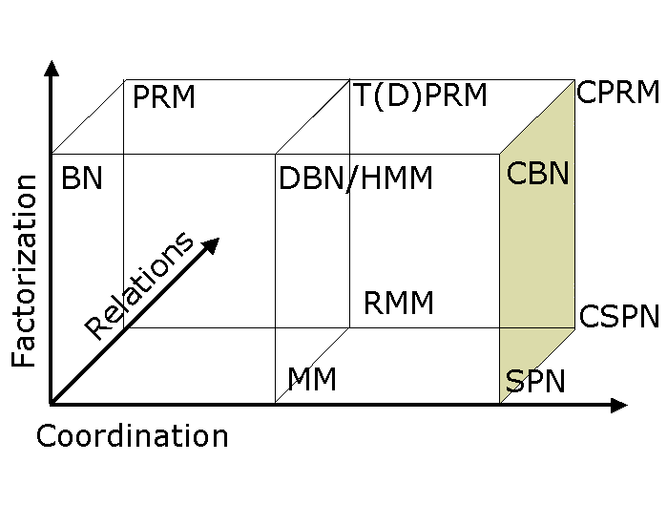
Structured
Probabilistic Inference
Dynamic Bayes Nets
Markov Logic Networks
Berkeley CPRM
Leon Barrett
PhD Thesis
(2010)
Bayes Nets
Stochastic Petri Nets
Continuous time Markov Chains

Slide 18
Event Models for Question Answering
Steve Sinha (PhD Thesis 2008)
Tackle prominent question types. Assumes question and frame analysis (UTD, Stanford)
Justification | Is Iran a signatory to the Chemical Weapons Convention?
Temporal Projection/ Prediction | What were the possible ramifications of India’s launch of the Prithvi missile?
Ability | Is Syria capable of producing nuclear weapons?
“What-if” Hypothetical | If Canada has Highly Enriched Uranium, is it capable of producing nuclear weapons?
System Identification | How does a management action reveal the possibility of legal or illegal programs?
System Control | What action is necessary to force management to follow a different trajectory?
Notes:
Again, you can ask about things like:
- what was the name of the event
- who participated in the event
people in the literature have looked at that
you can ask more interesting questions on
- causal and temporal relations
- event relations...
some of those include, (example questions we want to be able to do inference over)
justification, where you're trying to see if a proposition is true
temporal projection - you want to project from a state into the future...
ability - you want to know if someone can do something
hypothetical - perturb the system and do causal inferences from it

Slide 19
An integrated System for Computing with Natural Language
An integrated system combining
  Deep semantic analysis of language in context with
  A scalable simulation model
Best-fit Language Analyzer
  Embodied Construction Grammar (ECG)
    Construction Parser
      John Bryant PhD Thesis 2008
      Eva Mok PhD Thesis 2009
      Ellen Dodge PhD Thesis 2010
Scalable Domain Representation
  Event Models
      Steve Sinha PhD Thesis 2008
      Joe Makin PhD Thesis 2008
  Coordinated Probabilistic Relational Models
      Leon Barrett PhD Thesis 2010

Slide 20
ECG - NLU Beyond the 1980s
Much more computation
NLP technology
Construction Grammar: form-meaning pairs
Conceptual compositionality + Idioms, etc.
4. Cognitive Linguistics: Conceptual primitives
ECG = Embodied Construction Grammar; 6 distinct uses of formalism
5. Constrained Best Fit : Analysis, Simulation, Learning
Analysis uses Bayesian (form, meaning and context) best fit
6. Under-specification: Meaning involves context, goals, etc.
SemSpec = Semantic/Simulation Specification
7. Simulation Semantics; Meaning as action/simulation
8. CPRM= Coordinated Probabilistic Relational Models; Petri Nets ++
Action formalism works as a generative model
9. Domain Semantics; Need rich semantics on the Action side
10. General NLU front end: Modest effort to link to a new Action side

Slide 21
ECG for linguistic analysis
Constructional Analyzer (Bryant 2008)
  fits into the unified cognitive science (Feldman 2006)
  and builds on
    cognitive linguistics
    construction grammar
    psycholinguistics
    simulation-based language inference (Narayanan 1997)
    Natural Language Processing techniques

Slide 22
Construction grammar approach
Kay & Fillmore 1999; Goldberg 1995
Grammaticality: form and function in context
Basic unit of analysis: construction,
i.e. a pairing of form and meaning constraints
Conceptual not purely lexically compositional
Implies early use of semantics in processing
Embodied Construction Grammar (ECG)

Slide 23
Embodied Construction Grammar: ECG
ECG serves:
  as a technical tool for linguistic analysis
  to specify shared grammar, conceptual conventions of a linguistic community
  as a computer specification for implementing linguistic theories
  as a representation for models and theories of language acquisition
  as a front-end system for applied language-understanding tasks
  as a high-level functional description for biological and behavioral experiments

Slide 24
Productive Argument Omission (in Mandarin)
1
ma1+ma | gei3 | ni3 | zhei4+ge
mother | give | 2PS | this+CLS
Mother (I) give you this (a toy).
2
ni3 | gei3 | yi2
2PS | give | auntie
You give auntie [the peach].
3
ao | ni3 | gei3 | ya
EMP | 2PS | give | EMP
Oh (go on)! You give [auntie] [that].
4
gei3
give
[I] give [you] [some peach].
CHILDES Beijing Corpus (Tardiff, 1993; Tardiff, 1996)

Slide 25
Competition-based analyzer finds the best analysis
An analysis is made up of:
  A constructional tree
  A set of resolutions
  A semantic specification
The best fit has the highest combined score

Slide 26
Combined score that determines best-fit
Syntactic Fit: ~ Probabilisitic CFG
  Constituency relations
  Combine with preferences on non-local elements
  Conditioned on syntactic context
Antecedent Fit:
  Ability to find referents in the context
  Conditioned on syntactic information, feature agreement
Semantic Fit:
  Semantic bindings for scema roles
  Schema roles’ fillers are scored

Slide 27
Contextual information can trigger the learning of new constructions
World Knowledge
Utterance
Discourse & Situational Context
Linguistic Knowledge
Learning
Analysis
Partial
SemSpec
(Mok & Chang, 2006)

Slide 28
ECG Workbench
ECG Workbench:
  Based on Eclipse
  Takes advantage of and fully integrates with Eclipse RCP (Rich Client Platform)
  Makes it easy to enter, edit and check consistency of ECG grammars
  Can analyze text licensed by the grammar, producing a SemSpec (Semantic Specification)
  Download: http://www1.icsi.berkeley.edu/~lucag/

Slide 29
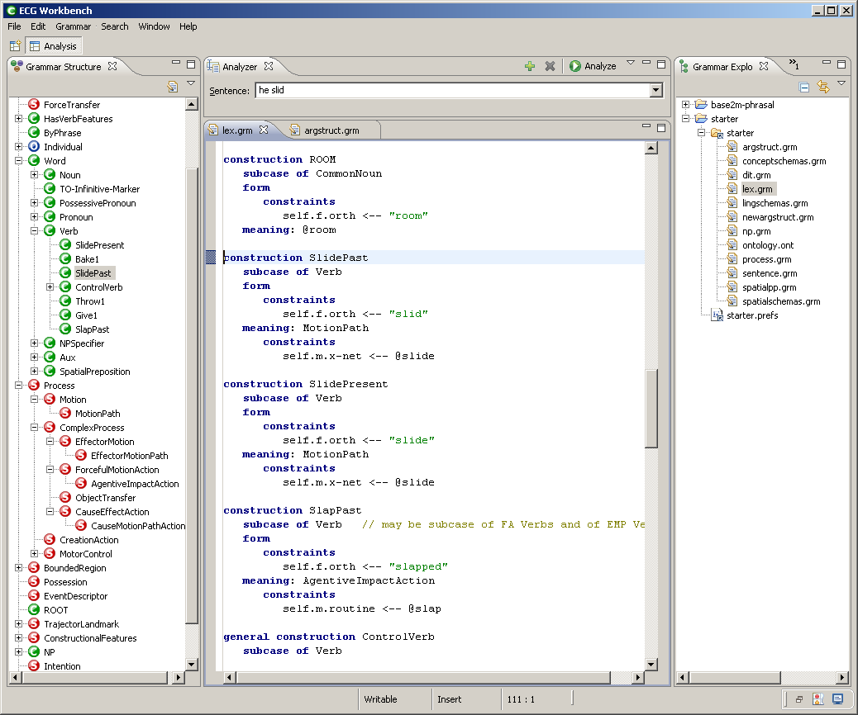
ECG for linguistic analysis
Workbench
  (Luca Gilardi)
  wraps the Constructional Analyzer
  two different uses
    simplifies creation and revising of grammars
    helps testing grammars

Slide 30
ECG for linguistic analysis
schema TrajectorLandmark
roles
trajector
landmark
profiledArea
ECG: the notation
  the semantics of he slid
TrajectorLandmark, SPG
  conventional image schemas
  related by inheritance
    SPG inherits all TL’s roles:
      trajector, landmark, profiledArea
MotionAlongAPath
  actions involving a protagonist
  the path is represented by the evoked SPG
    evokes introduces a new role
    the mover is bound to the trajector of the evoked SPG
schema SPG
subcase of TrajectorLandmark
roles
source
path
goal
schema MotionAlongAPath
subcase of Motion
evokes SPG as spg
constraints
mover ↔ spg.trajector

Slide 31
ECG for linguistic analysis
ECG: the notation
  the semantics of he slid
Motion
  a subcase of Process
  the mover and the protagonist are bound together by the double arrows
    i.e., the mover is the primary participant in a Motion action
  the x-net role is typed to be of the x-schematic type motion
  @process is in external ontology
x-schemas
  fine-grained process structure representations
    e.g. walking, pushing, sliding can all be represented as x-schematic structures
schema Process
roles
protagonist
x-net: @process
schema Motion
subcase of Process
roles
mover: @entity
speed // scale
heading // place
x-net: @motion // modified
constraints
mover ↔ protagonist

Slide 32
Schema Lattice
Contact
MotorControl
ForceTransfer
Motion
ForceApplication
Effector
Motion
SelfMotion
CauseEffect
MotionPath
Effector
MotionPath
SPG
SelfMotion
Path
Agentive Impact
SpatiallyDirectedAction
Contact
Notes:
This slide shows ForceApplication and MotorControl schemas as part of a still larger network of schemas.
→ Main point is to show that schema relations, structures are complex, as are the neural structures they are intended to represent
→ In ECG cxns, meaning representations are often quite complex, but they are not creating this complexity for the purpose of linguistic analysis. The complexity already exists – by including it in the representations, we can improve the analysis.

Slide 33
ECG for linguistic analysis
ECG: the notation
  the semantics of he slid
Just two more schemas
  EventDescriptor (or ED)
    the meaning of an entire scene
    the verb’s meaning is usually bound to profiledProcess
  ReferentDescriptor (or RD)
    typically represents constraints associated with referents of nominal and pronominal constructions
schema EventDescriptor
roles
eventType: Process
profiledProcess: Process
profiledParticipant
profiledState
spatialSetting
temporalSetting
schema RD
roles
ontological-category
givenness
referent
number

Slide 34
ECG for linguistic analysis
ECG: the notation
  the analysis of he slid
Clause-level construction
  Declarative: brings together
    a subject (an NP constituent),
      the construction for He is a subcase of NP
    and a finite verb phrase, fin, of type VerbPlusArguments
    IntransitiveArgStructure is a subcase of this
    (green marks the inherited structure)
construction Declarative
subcase of S-With-Subj
constructional
constituents
subj: NP
fin: VerbPlusArguments
form
constraints
subj.f before fin.f
meaning
constraints
subj.m.referent ↔ self.m.profiledParticipant
self.m ↔ fin.ed
self.m.speechAct ← "Declarative”

Slide 35
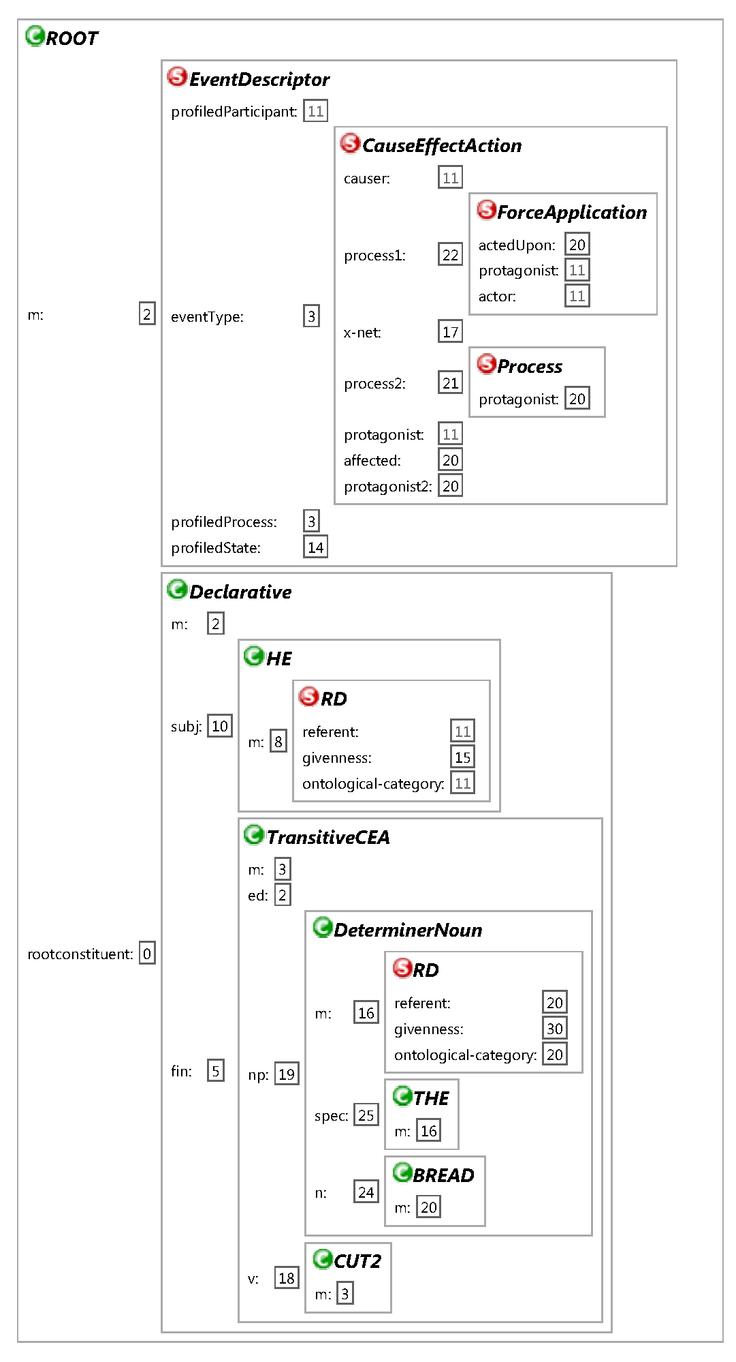

Slide 36
ECG - NLU Beyond the 1980s
Much more computation
NLP technology
Construction Grammar: form-meaning pairs
Conceptual compositionality + Idioms, etc.
4. Cognitive Linguistics: Conceptual primitives
ECG = Embodied Construction Grammar; 6 distinct uses of formalism
5. Constrained Best Fit : Analysis, Simulation, Learning
Analysis uses Bayesian (form, meaning and context) best fit
6. Under-specification: Meaning involves context, goals, etc.
SemSpec = Semantic/Simulation Specification
7. Simulation Semantics; Meaning as action/simulation
8. CPRM= Coordinated Probabilistic Relational Models; Petri Nets ++
Action formalism works as a generative model
9. Domain Semantics; Need rich semantics on the Action side
10. General NLU front end: Modest effort to link to a new Action side

Slide 37
Action Language Understanding System
Demonstrate utility through a series of scalable prototypes
  that show the ability of the system to handle increasingly complex language
  in a general way across multiple tasks and environments
  to support communication in communities comprised of both human and artificial agents
Current Goal: Implement a prototype system that can follow instructions and synthesize actions and procedures expressed in natural language.
  This requires the system to analyze natural language and translate this language in context into a coordinated network of actions and complex commands.

Slide 38


Integrated Pilot System for Action Synthesis
Robot1, move North!
World
API ~ Morse etc.
Discourse Analyzer
ECG Grammar
Situation
(PRM Inference)
Actions
(X-nets)
Shared
Ontology
SemSpec
Specializer
Application
Problem Solver
Compiled
CPRM
N-Tuples

Slide 39
Sentence: "Robot1, move North!" Cost: -16.686874963360513
Analysis: ROOT(0, 5)
Constructions Used:
ROOT[1] (0, 5)
AddressedImperative[0] (0, 5)
ROBOT1[11] (0, 1)
Comma[4] (1, 2)
SimpleImperative[5] (2, 4)
ActiveMotionPath[27] (2, 4)
MoveBase[47] (2, 3)
North[48] (3, 4)
IMark[7] (4, 5)
Schemas Used:
DiscourseElement[2]
EventDescriptor[3]
@sentient[6]
RD[8]
@robot[9]
RD[10]
@mood[12]
@boundingValues[14] @singular[18]
@hedgeVal[20]
@scale[22]
@givennessValues[16]
@neuter[17] @robot1-instance[23]
NominalFeatureSet[24]
Amount[25]
@EventKind[28]
MotionPath[29]
        Base[30]
VerbFeatureSet[31]
EventFeatures[32]
@move[35]
RD[36]
@location[39]
A123[40]
QuantifiedSpatialRD[41]
SPG[42]
NotPassive[43]
@notPassive[44]
ProcessFeatures[45]
NotTransitive[49]
@north[51]

Slide 40
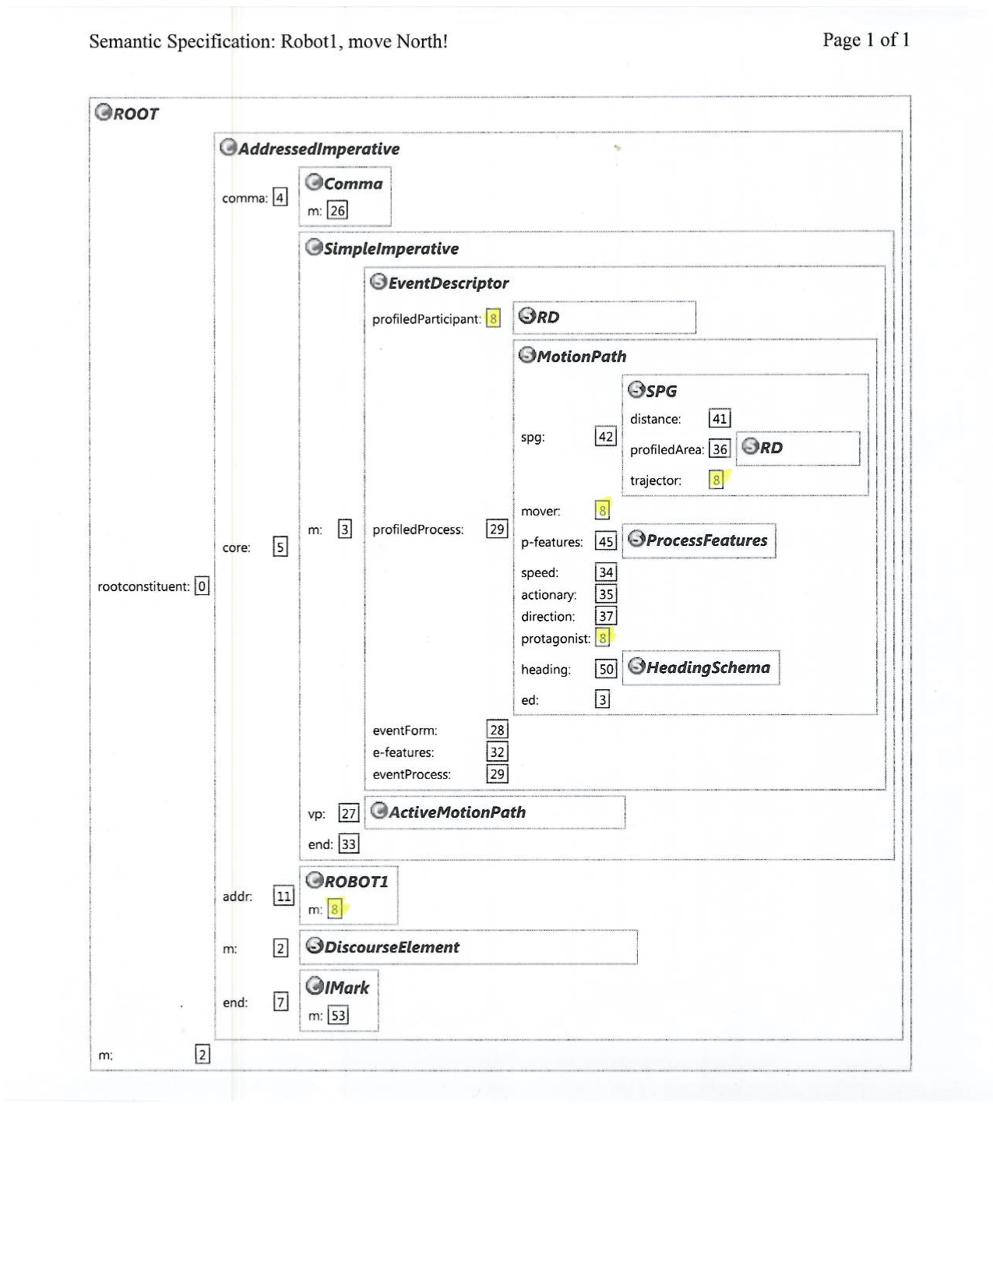

Slide 41
Research Scientist or Postdoctoral Fellow Opening at ICSI
The International Computer Science Institute (ICSI) in Berkeley invites applications for a Research Scientist or Postdoctoral Fellow position in the area of applying deep semantic models of language to natural language interfaces for varying applications. The post is available now.
The Fellow will be working with Prof. Jerome Feldman and ICSI's Artificial Intelligence group on designing, implementing, and evaluating systems to bridge between specific knowledge-intensive applications and the existing ICSI systems for deep semantic analysis and simulation.
We are looking for candidates with a strong AI and systems background, ideally including previous work with natural language interfaces. Familiarity with current NLP systems and with agent support systems like JADE is required. Some experience with (simulated) robotics would be helpful.
To apply, email an application to: jobs@icsi.berkeley.edu , including a cover letter, curriculum vitae and contact information for at least two references.

Slide 42





The ICSI Metaphor Project Team
ICSI, UCB
  PI: James Hieronymus
  Srini Narayanan (AI and Cognitive Science)
  George Lakoff (Linguistics and Cognitive Science)
  Collin Baker (Project Manager, Linguistics)
  Jerome Feldman (EECS and Cognitive Science)
  Ekaterina Shutova (Computational Linguistics)
ICSI/CMU-Qatar
  Behrang Mohit (NLP, MT, Persian Expert)
ICSI/UC Merced
  Teenie Matlock (Cognitive Science)
UCSD
  Ben Bergen (Cognitive Science)
  Lera Boroditsky (Psychology)
USC
  Lisa Aziz-Zadeh (Neuroscience)
ICSI/Eötvös Loránd University, Hungary
  Zoltan Kovecses (Language)

Slide 43
Metaphor Project Goals
Build a methodology for metaphor analysis
  Automated extraction
  Cross-cultural repository
  Affect identification
  Belief/world-view discovery
Validate/Evaluate methodology
  Extraction in four languages for target concepts
    English, Persian, Russian, Spanish
  Computational model based on Cognitive Linguistics results
    Functional repository with framings and mappings
    Mappings at multiple levels and cultural variations
    Dimensions relevant to world-views/belief discovery and intervention
  Demonstrate coherence, inference, decision impact of metaphors in a series of case studies
  Investigate metaphoric affect and role in decision making

Slide 45
Productive Argument Omission (in Mandarin)
1
ma1+ma | gei3 | ni3 | zhei4+ge
mother | give | 2PS | this+CLS
Mother (I) give you this (a toy).
2
ni3 | gei3 | yi2
2PS | give | auntie
You give auntie [the peach].
3
ao | ni3 | gei3 | ya
EMP | 2PS | give | EMP
Oh (go on)! You give [auntie] [that].
4
gei3
give
[I] give [you] [some peach].
CHILDES Beijing Corpus (Tardiff, 1993; Tardiff, 1996)

Slide 46
Arguments are omitted with different probabilities
All arguments omitted: 30.6% No arguments omitted: 6.1%

Slide 47
Best-fit analysis process takes the burden off of the grammar representation
Constructions
Utterance
Discourse & Situational Context
Analyzer:
incremental,
competition-based, psycholinguistically plausible
Semantic Specification:
image schemas, frames,
action schemas
Simulation

Slide 48
Competition-based analyzer finds the best analysis
An analysis is made up of:
  A constructional tree
  A set of resolutions
  A semantic specification
The best fit has the highest combined score

Slide 49
Combined score that determines best-fit
Syntactic Fit:
  Constituency relations
  Combine with preferences on non-local elements
  Conditioned on syntactic context
Antecedent Fit:
  Ability to find referents in the context
  Conditioned on syntactic information, feature agreement
Semantic Fit:
  Semantic bindings for frame roles
  Frame roles’ fillers are scored

Slide 50
Analyzing ni3 gei3 yi2 (You give auntie)
Two of the competing analyses:
ni3 | gei3 | yi2 | omitted
↓ | ↓ | ↓ | ↓
Giver | Transfer | Recipient | Theme
ni3 | gei3 | omitted | yi2
↓ | ↓ | ↓ | ↓
Giver | Transfer | Recipient | Theme
Syntactic Fit:
  P(Theme omitted | ditransitive cxn) = 0.65
  P(Recipient omitted | ditransitive cxn) = 0.42
(1-0.78)*(1-0.42)*0.65 = 0.08
(1-0.78)*(1-0.65)*0.42 = 0.03

Slide 51
Can the omitted argument be recovered from context?
Antecedent Fit:
ni3 | gei3 | yi2 | omitted
↓ | ↓ | ↓ | ↓
Giver | Transfer | Recipient | Theme
ni3 | gei3 | omitted | yi2
↓ | ↓ | ↓ | ↓
Giver | Transfer | Recipient | Theme
Discourse & Situational
Context
  child mother
  peach auntie
  table
?

Slide 52
How good of a theme is a peach?
How about an aunt?
Semantic Fit:
ni3 | gei3 | yi2 | omitted
↓ | ↓ | ↓ | ↓
Giver | Transfer | Recipient | Theme
ni3 | gei3 | yi2 | omitted
↓ | ↓ | ↓ | ↓
Giver | Transfer | Recipient | Theme
ni3 | gei3 | omitted | yi2
↓ | ↓ | ↓ | ↓
Giver | Transfer | Recipient | Theme
The Transfer Frame Giver (usually animate) Recipient (usually animate) Theme (usually inanimate)

Slide 53
The argument omission patterns shown earlier can be covered with just ONE construction
Subj | Verb | Obj1 | Obj2
↓ | ↓ | ↓ | ↓
Giver | Transfer | Recipient | Theme
P(omitted|cxn):
0.78
0.42
0.65
Each construction is annotated with probabilities of omission
Language-specific default probability can be set

Slide 54
Contextual information can trigger the learning of new constructions
World Knowledge
Utterance
Discourse & Situational Context
Linguistic Knowledge
Learning
Analysis
Partial
SemSpec
(Mok & Chang, 2006)

Slide 55
Language as Logic
Yet every sentence is not a proposition; only such are propositions that have in them truth or falsity. Thus a prayer is a sentence, but it is neither true nor false. Let us therefore dismiss all other types of sentences but the proposition, for this last concerns our present inquiry, whereas the investigation of others belongs rather to the study of rhetoric or poetry.
Aristotle (De Interpretatione 17a1-8).

Slide 56
Functionalism
In fact, the belief that neurophysiology is even relevant to the functioning of the mind is just a hypothesis. Who knows if we’re looking at the right aspects of the brain at all. Maybe there are other aspects of the brain that nobody has even dreamt of looking at yet. That’s often happened in the history of science. When people say that the mental is just the neurophysiological at a higher level, they’re being radically unscientific. We know a lot about the mental from a scientific point of view. We have explanatory theories that account for a lot of things. The belief that neurophysiology is implicated in these things could be true, but we have very little evidence for it. So, it’s just a kind of hope; look around and you see neurons: maybe they’re implicated.
Noam Chomsky 1993, p.85

