Slide 1
Simulation Semantics,
Embodied Construction Grammar, and the Language of Actions and Events
Jerome Feldman
feldman@icsi.berkeley.edu

Slide 2
Embodiment
Of all of these fields, the learning of languages would be the most impressive, since it is the most human of these activities. This field, however, seems to depend rather too much on the sense organs and locomotion to be feasible.
Alan Turing (Intelligent Machines,1948)
< Continuity Principle of Darwin, American Pragmatists >

Slide 3
ECG - NLU Beyond the 1980s
Much more computation
NLP technology
Construction Grammar: form-meaning pairs
Conceptual compositionality + Idioms, etc.
4. Cognitive Linguistics: Conceptual primitives
ECG = Embodied Construction Grammar; 6 distinct uses of formalism
5. Constrained Best Fit : Analysis, Simulation, Learning
Analysis uses Bayesian (form, meaning and context) best fit
6. Under-specification: Meaning involves context, goals, etc.
SemSpec = Semantic/Simulation Specification
7. Simulation Semantics; Meaning as action/simulation
8. CPRM= Coordinated Probabilistic Relational Models; Petri Nets ++
Action formalism works as a generative model
9. Domain Semantics; Need rich semantics on the Action side
10. General NLU front end: Modest effort to link to a new Action side

Slide 4
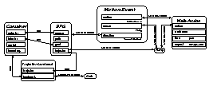
Language understanding: analysis & simulation
construction WALKED
form
self_{f}.phon ← [wakt]
meaning : Walk-Action
constraints
self_{m}.time before Context.speech-time
self_{m}..aspect ← encapsulated
“Harry walked into the cafe.
Utterance
Constructions
Lexicon
Analysis Process
General Knowledge
Semantic
Specification
Belief State
CAFE
Simulation

Slide 5
Active representations
Many inferences about actions derive from what we know about executing them
X-net representation based on stochastic Petri nets captures dynamic, parameterized nature of actions
Used for acting, recognition, planning, and language
walker at goal
  Walking: bound to a specific walker with a direction or goal
  consumes resources (e.g., energy)
  may have termination condition
  (e.g., walker at goal)
  ongoing, iterative action
energy
walker=Harry
goal=home
Notes:
Certain words are closely associated with biological phenomena.
Simple representation based on petri nets.
Action/event representation has in common with motor control the need to refer to
process states and transitions;
and resource consumption/production; parameters.
Part of learning/understanding words like “push”, “walk” clearly involves grounded knowledge about how to perform the action, as well as quite complex/concrete inferences based on execution. (e.g....)
Note: these representations might be parameterized: “shove”, “walk slowly”, “walk home”
and NOTE: this model of action is accurate cross-linguistically, even if some specific conditions on word meaning varies from language to language.
This may seem complex, but in fact VERY early children seem to have no problem performing and understanding words like this. And more complicated ones too!

Slide 6
Embodied Construction Grammar: ECG
ECG serves:
  as a technical tool for linguistic analysis
  to specify shared grammar, conceptual conventions of a linguistic community
  as a computer specification for implementing linguistic theories
  as a representation for models and theories of language acquisition
  as a front-end system for applied language-understanding tasks
  as a high-level functional description for biological and behavioral experiments

Slide 7
ECG Workbench
ECG Workbench:
  Based on Eclipse
  Takes advantage of and fully integrates with Eclipse RCP (Rich Client Platform)
  Makes it easy to enter, edit and check consistency of ECG grammars
  Can analyze text licensed by the grammar, producing a SemSpec (Semantic Specification)
  Download: http://www1.icsi.berkeley.edu/~lucag/

Slide 8
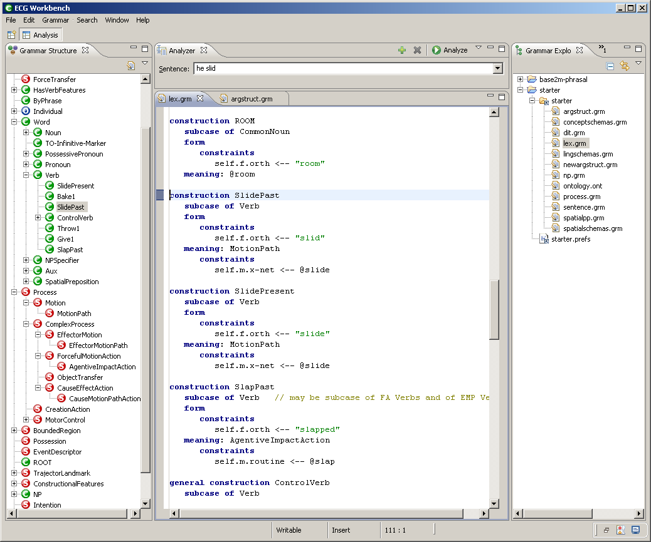
ECG for linguistic analysis
Workbench
  (Luca Gilardi)
  wraps the Constructional Analyzer
  two different uses
    simplifies creation and revising of grammars
    helps testing grammars

Slide 9
Action Language Understanding System
Demonstrate utility through a series of scalable prototypes
  that show the ability of the system to handle increasingly complex language
  in a general way across multiple tasks and environments
  to support communication in communities comprised of both human and artificial agents
Current Goal: Implement a prototype system that can follow instructions and synthesize actions and procedures expressed in natural language.
  This requires the system to analyze natural language and translate this language in context into a coordinated network of actions and complex commands.

Slide 10


Integrated Pilot System for Action Synthesis
Robot1, move North!
World
API ~ Morse etc.
DiscourseAnalyzer
ECG Grammar
Situation
Actions
Ontology
Application
Problem Solver
SemSpec
Specializer
N-Tuples
Compiled

Slide 11
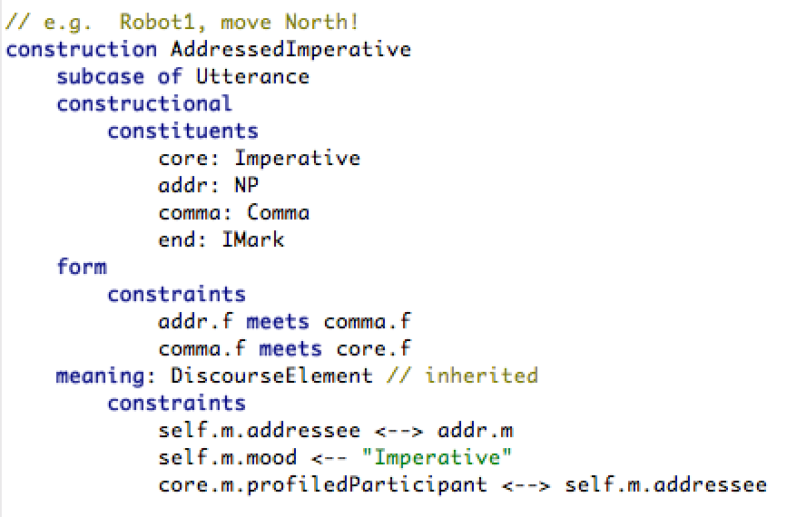
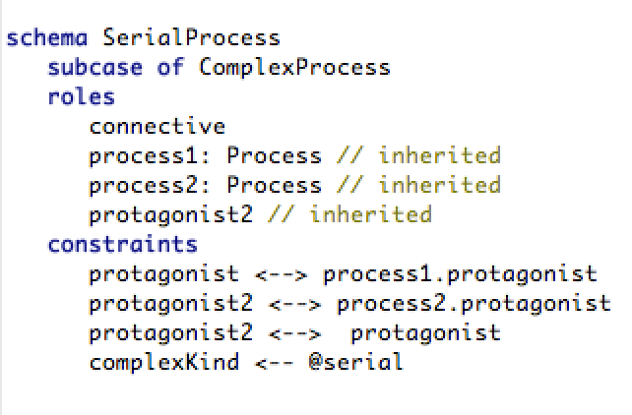
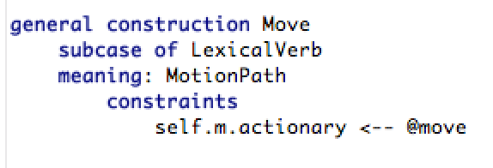
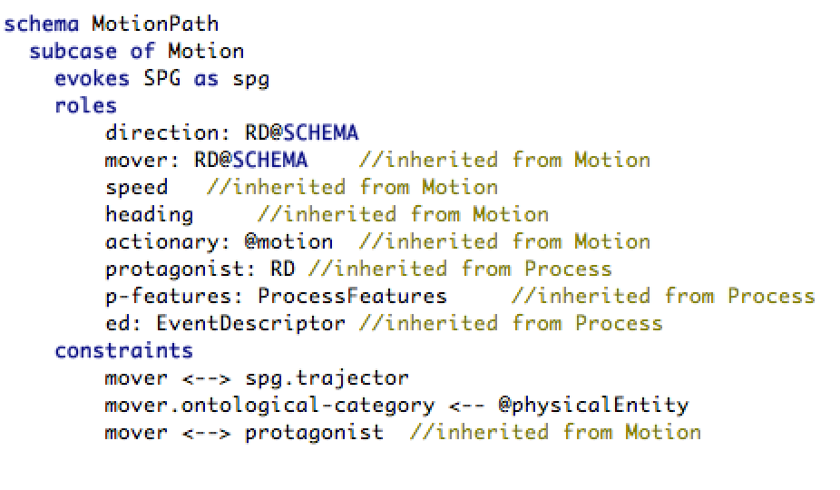
Robot1, move North then return!

Slide 12
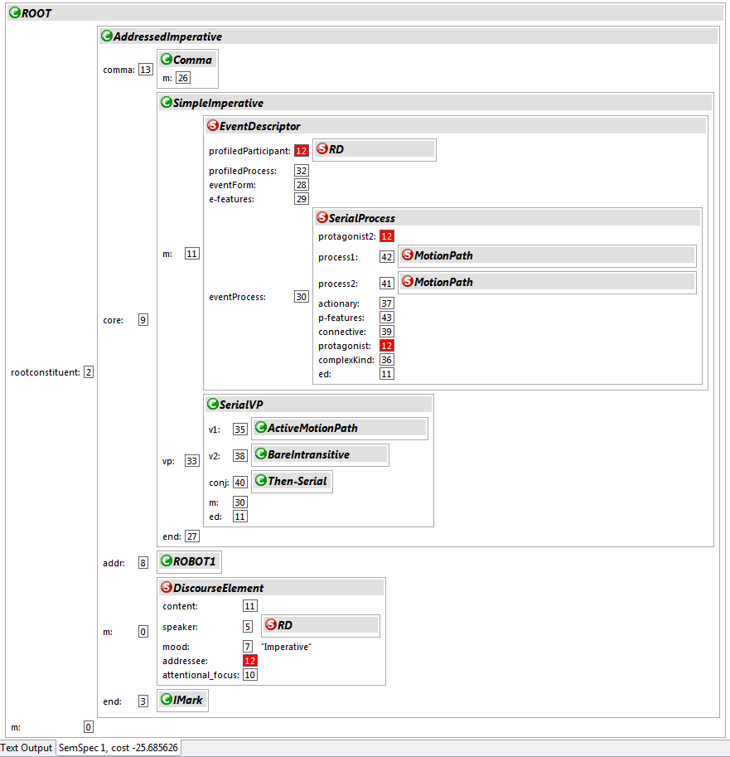
Analyzer
Robot1, move North then return!

Slide 13
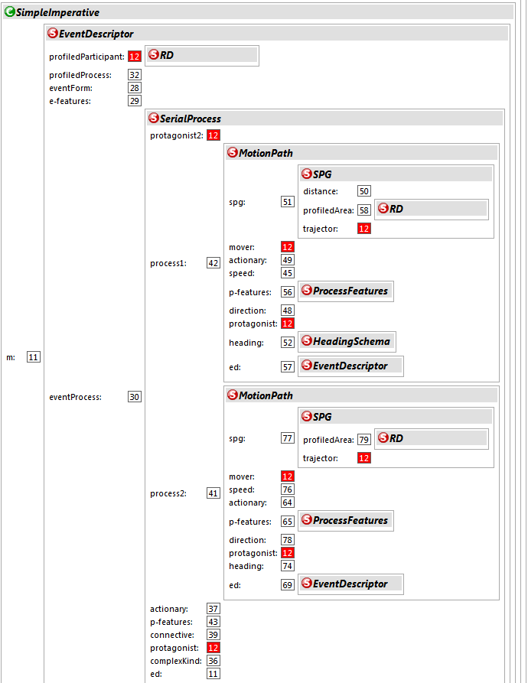
Robot1, move North then return!

Slide 14
Integrated Pilot System for Action Synthesis
Robot1, move North!
World
API ~ Morse etc.
DiscourseAnalyzer
ECG Grammar
Situation
Actions
Ontology
Application
Problem Solver
SemSpec
Specializer
N-Tuples
Compiled

Slide 15
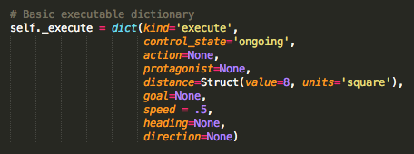
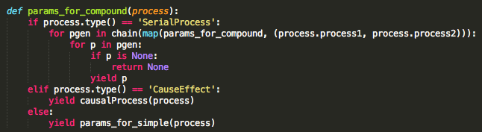
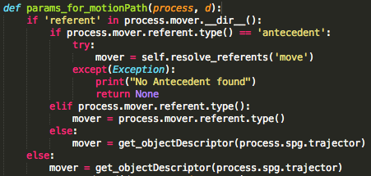
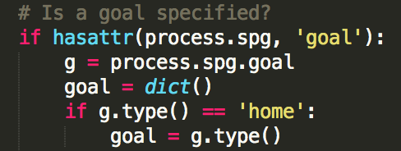

Specializer
Initialize executable template
Parse serial processes
Assign values in SemSpec to template

Slide 16
N-Tuple
[Struct(protagonist='robot1_instance',
heading='north',
goal=None,
kind='execute',
speed=0.5,
action='move',
distance=Struct(units='square', value=8),
direction=None, control_state='ongoing'),
Struct(protagonist='robot1_instance',
heading=None,
goal={'location': 'home'},
kind='execute',
speed=0.5,
action='move',
distance=Struct(units='square', value=8),
direction=None,
control_state='ongoing')]
Parameters of message
Struct(speed=0.5,
action='move',
protagonist='robot1_instance',
distance=Struct(units='square', value=6),
direction=None, control_state='ongoing',
kind='execute',
heading=None,
goal={'location': 'home'})
Struct(speed=0.5,
action='move',
protagonist='robot1_instance',
distance=Struct(units='square', value=6),
direction=None,
control_state='ongoing',
kind='execute',
heading='north',
goal=None)
First part of N-tuple received by Solver; contains information for first part of serial process (“move North”)
Second part of N-tuple received by Solver; contains information for second part of serial process (“return”)

Slide 17
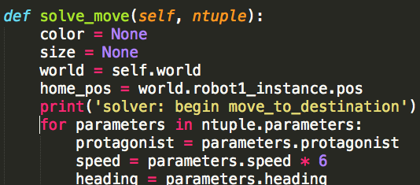
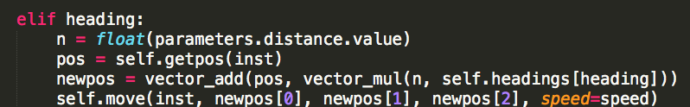
Solver
Unpacks N-tuple passed from Specializer.
Determines heading of movement vector (“move North”).
Returns to “home” position, stored in prior state variable.

Slide 18
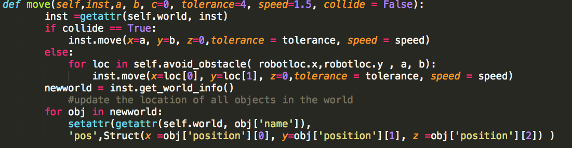
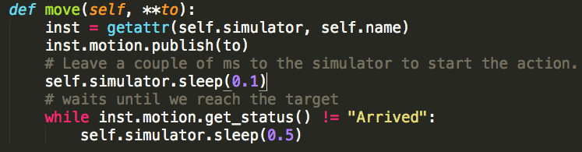
Morse (Robot Simulator)
Moves robot
Gets the new
state of the
world
Updates internal
model of the world
Moves the robot in simulation
(and waits for it to arrive)
Gets the updated state of the world

Slide 19
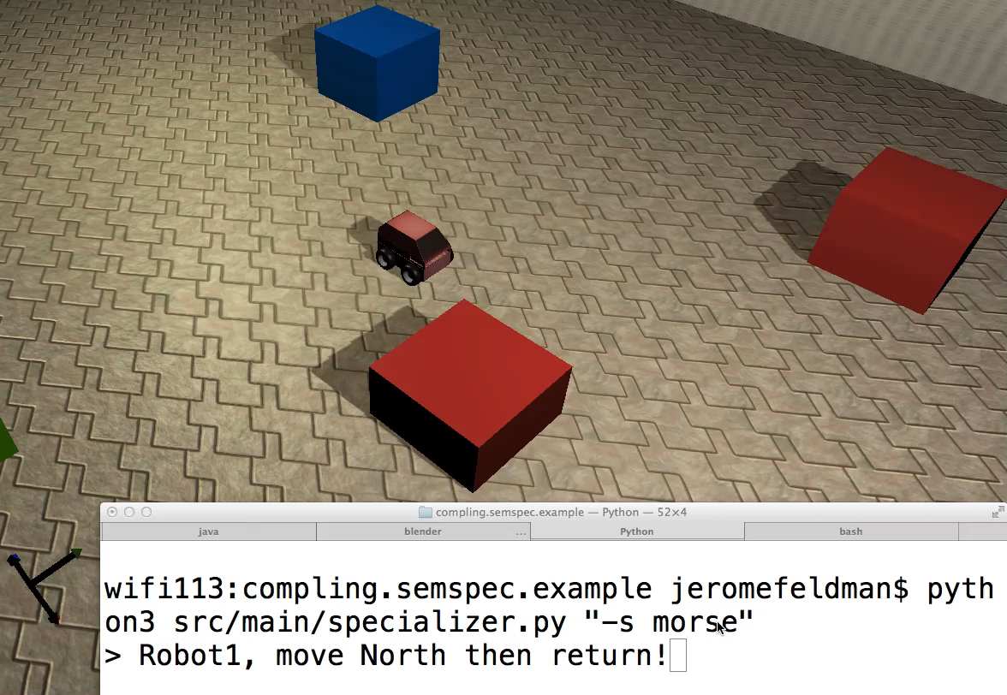
Robot Simulation

