Slide 1
EE 225D, Section I: Broad background
Synthesis/vocoding history (chaps 2&3)
Recognition history (chap 4)
Machine recognition basics (chap 5)
Human recognition basics (chap 18)

Slide 2
Synthetic Audio
A Brief Historical Introduction

Slide 3
Generating sounds
Synthesis can be “additive” or “subtractive”
Additive means combining components (e.g., sinusoids)
Subtractive means filtered
Analogy to physical mechanisms
The human speech example …

Slide 5
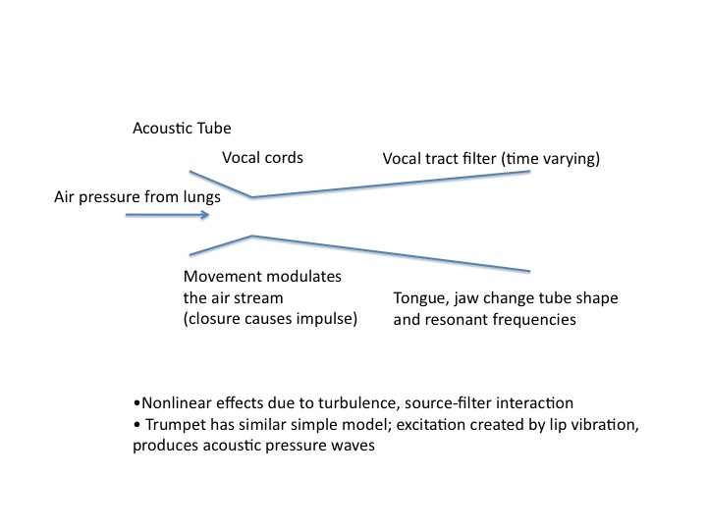

Slide 6
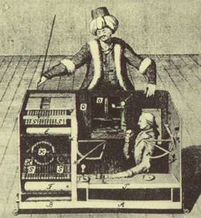
Von Kempelen’s chess-playing “automaton” (~1770)

Slide 7
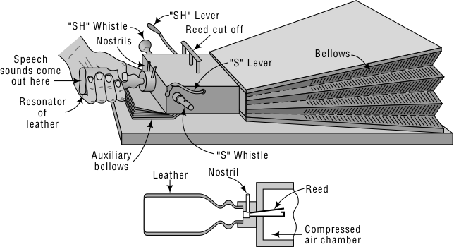
Wheatstone speaking machine, 1837 (after von Kempelen, ~1780)

Slide 8
Wheatstone’s Speaking Machine (from von Kempelen)
Vibrating reed to simulate vocal cords
Nasal passage
Bellows for producing pressure
Leather “vocal tract”
Whistles for “s” and “sh” sounds

Slide 9
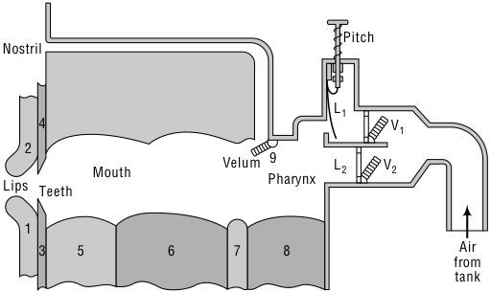
Riesz’s speaking machine (1930s)

Slide 10
The Voice Operation Demonstrator (Voder)
Shown at New York World’s Fair, 1939; also San Francisco Exhibition, 1939
Apparently the first electronic synthesizer
Required a human operator, long training
Related to human voice production, but not a physical model (no tongue analogy, etc.)
Used filters to model the effect of varying vocal tract shape

Slide 11
(Extremely) Simplified Model of Speech Production
Periodic
source
voiced
Filters
Coupling
Speech
unvoiced
Noise
source
What does the spectrum of a periodic source look like?

Slide 12
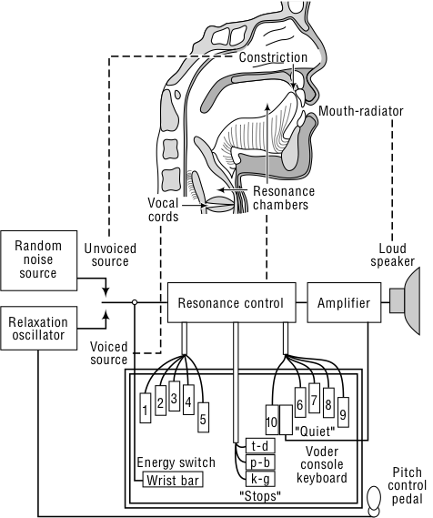
Voder controls

Slide 13
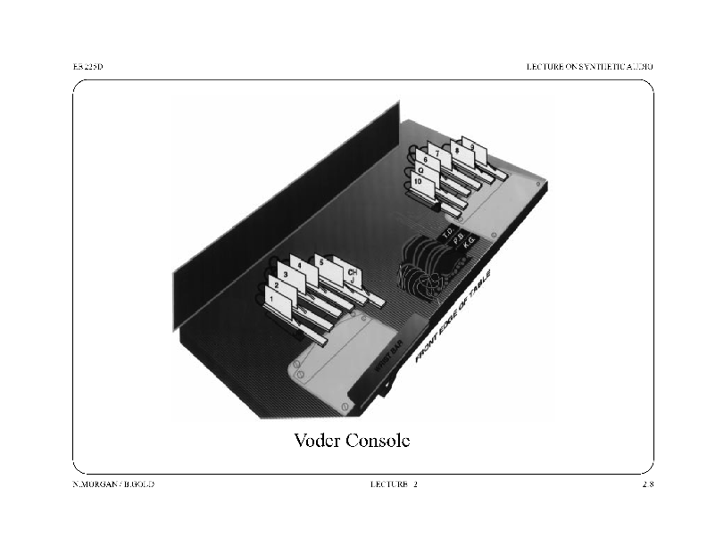

Slide 14
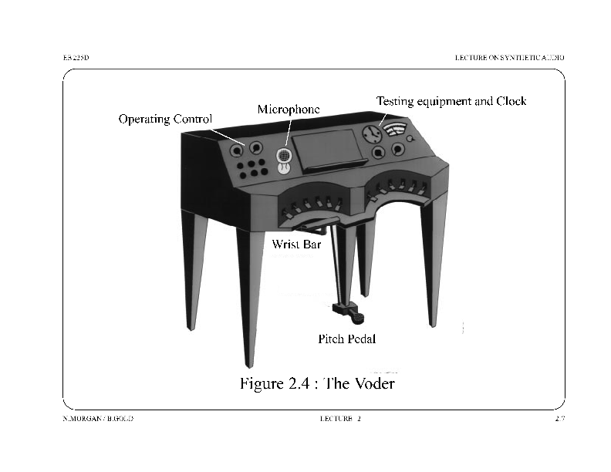

Slide 15
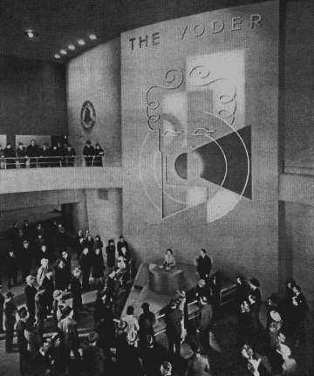
The Voder at the 1939 World’s Fair in New York

Slide 16
VODER EXAMPLES
Daisy
Extended demo

Slide 17
Excitations for speech sounds
Periodic: vowels, glides, liquids
Noise: voiceless fricatives (f,s)
Both: voiced fricatives (v,z)
Burst-like sounds: p-b,k-g,t-d

Slide 18
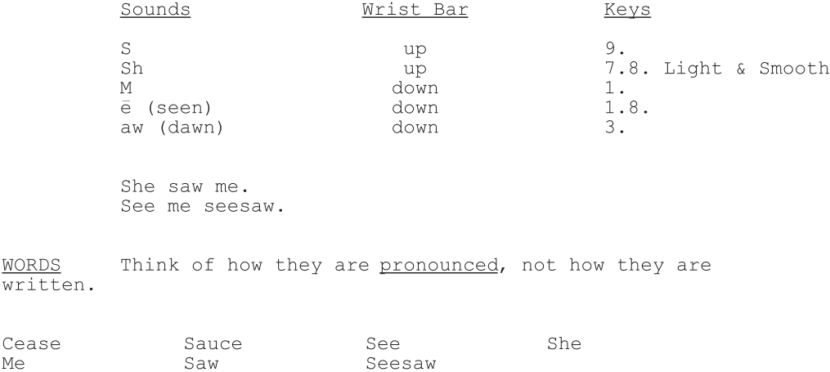
Lesson 1 of the voder instructions

Slide 19
Later Speech Synthesis methods
Phonemic Synth by rule: 1961
Cascaded resonances (Fant, 1953)
Parallel resonances (Holmes, 1973) (synth followed by natural)
KlattTalk -> DECTalk (1970’s)
Speak & Spell (1979)
Concatenation (unit selection)
The newest: HMM synthesis
More on synthesis later in course

Slide 20
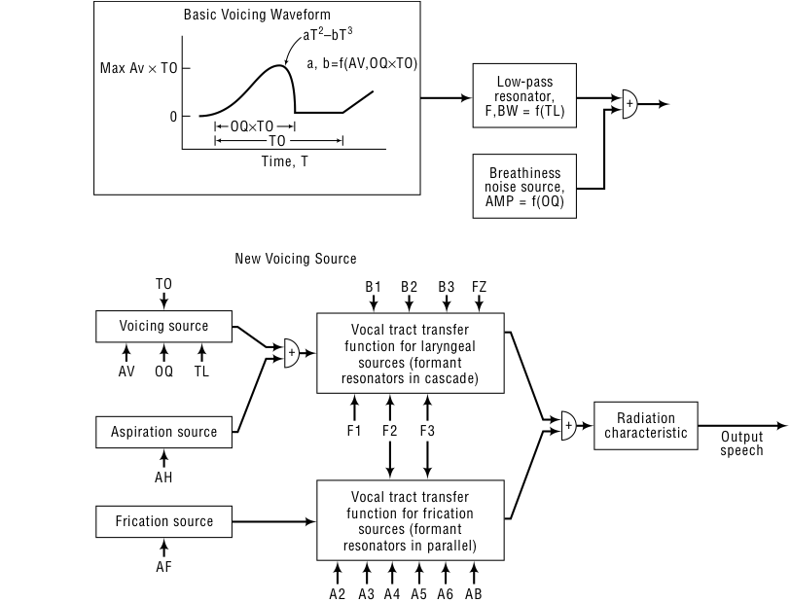
The Klatt synthesizer, later implemented for DEC as DECtalk

Slide 21
Speech frequency components
CNMAT site

Slide 22
Music Machines
Barrel organs (water or spring powered)
Like music boxes, pins pluck or depress keys
Melography (18th century) - writable medium
Punched cards, as in Jacquard loom
Player pianos -> modern digital versions (Bosendorfer)
Telharmonium - additive sinusoidal synthesis
Lots of 1900 generators = one huge machine

Slide 23
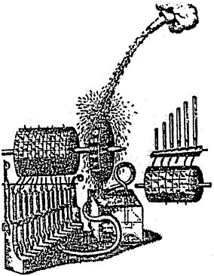
17th century drawing of a water-powered barrel organ

Slide 24
Electronic music
Theramin - player varies capacitances, alters frequency and amplitude for sinusoid
Analog synthesizers - oscillators, mixers, etc. - Moog, later FM synthesis
Digital synthesizers - the modern way

Slide 25
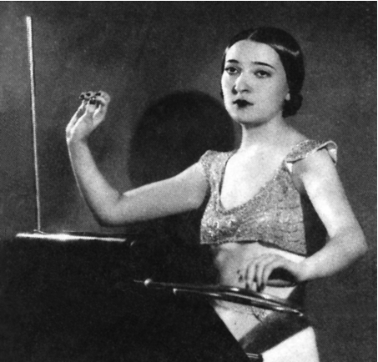
Clara Rockmore at the theremin

Slide 26
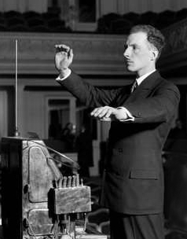
Léon Theremin (originally Lev Sergeyevich Termen) at his instrument

Slide 27
Common electronic waveforms
CNMAT site

Slide 28
