Slide 1
EE 225D, Section I: Broad background
Synthesis/vocoding history (chaps 2&3)
Short homework: exercises 2.3, 3.1
(send to morgan@icsi.berkeley.edu by Monday)
(if you don’t have the book, look in homework.html in the spr14 directory)
Recognition history (chap 4)
Machine recognition basics (chap 5)
Human recognition basics (chap 18)

Slide 2
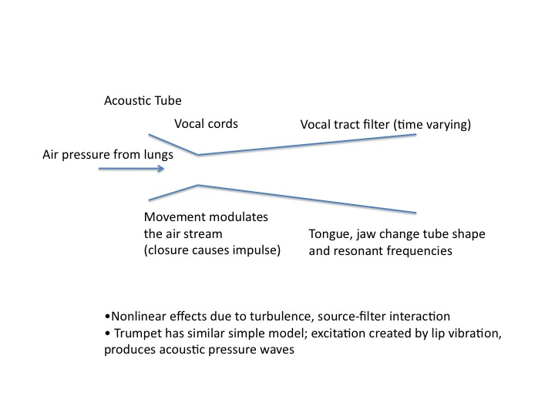

Slide 3
(Extremely) Simplified Model of Speech Production
Periodic
source
voiced
Filters
Coupling
Speech
unvoiced
Noise
source

Slide 4
Fine structure and spectral envelope of a sustained vowel

Slide 5
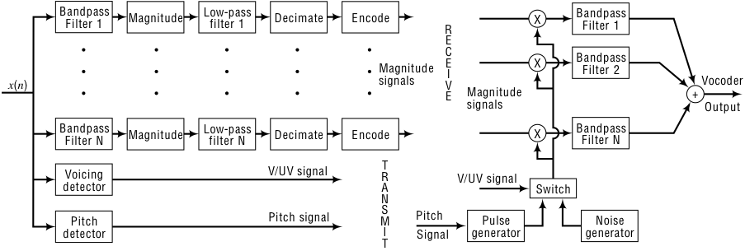
Channel Vocoder: analysis
Channel Vocoder: synthesis

Slide 6
What do people perceive?
Determine pitch
Also determine location (binaural)
Seemingly extract envelope (filters)
Also evidence for temporal processing
Overall, speech very redundant, human perception very forgiving
More about this later

Slide 7
ASR Intro: Outline
ASR Research History
Difficulties and Dimensions
Core Technology Components
21st century ASR Research

Slide 8
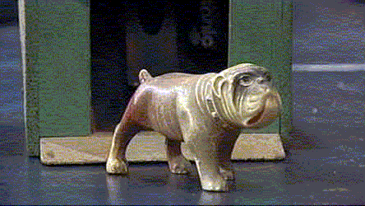
Radio Rex – 1920’s ASR

Slide 9
Radio Rex
“It consisted of a celluloid dog with an iron base held within its house by an electromagnet against the force of a spring. Current energizing the magnet flowed through a metal bar which was arranged to form a bridge with 2 supporting members. This bridge was sensitive to 500 cps acoustic energy which vibrated it, interrupting the current and releasing the dog. The energy around 500 cps contained in the vowel of the word Rex was sufficient to trigger the device when the dog’s name was called.”

Slide 10
1952 Bell Labs Digits
First word (digit) recognizer
Approximates energy in formants (vocal tract resonances) over word
Already has some robust ideas (insensitive to amplitude, timing variation)
Worked very well
Main weakness was technological (resistors and capacitors)

Slide 11
Digit Patterns
Axis
Crossing
Counter
HP filter (1 kHz)
(kHz)
3
Limiting
Amplifier
Spoken
2
Digit
1
Axis
Crossing
Counter
200
800
(Hz)
LP filter (800 Hz)
Limiting
Amplifier

Slide 12
The 60’s
Better digit recognition
Breakthroughs: Spectrum Estimation (FFT, cepstra, LPC), Dynamic Time Warp (DTW), and Hidden Markov Model (HMM) theory
1969 Pierce letter to JASA: “Whither Speech Recognition?”

Slide 13
Pierce Letter
1969 JASA
Pierce led Bell Labs Communications Sciences Division
Skeptical about progress in speech recognition, motives, scientific approach
Came after two decades of research by many labs

Slide 14
Pierce Letter (Continued)
ASR research was government-supported.
He asked:
Is this wise?
Are we getting our money’s worth?

Slide 15
Purpose for ASR
Talking to machine had (“gone downhill since…….Radio Rex”)
Main point: to really get somewhere, need intelligence, language
Learning about speech Main point: need to do science, not just test “mad schemes”

Slide 16
1971-76 ARPA Project
Focus on Speech Understanding
Main work at 3 sites: System Development Corporation, CMU and BBN
Other work at Lincoln, SRI, Berkeley
Goal was 1000-word ASR, a few speakers, connected speech, constrained grammar, less than 10% semantic error

Slide 17
Results
Only CMU Harpy fulfilled goals - used LPC, segments, lots of high level knowledge, learned from Dragon * (Baker)
* The CMU system done in the early ‘70’s; as opposed to the company formed in the ‘80’s

Slide 18
Achieved by 1976
Spectral and cepstral features, LPC
Some work with phonetic features
Incorporating syntax and semantics
Initial Neural Network approaches
DTW-based systems (many)
HMM-based systems (Dragon, IBM)

Slide 19
Automatic Speech Recognition
Data Collection
Pre-processing
Feature Extraction (Framewise)
Hypothesis Generation
Cost Estimator
Decoding

Slide 20
Framewise Analysis
of Speech
Frame 1
Frame 2
Feature Vector X₁
Feature Vector X₂

Slide 21
1970’s Feature Extraction
Filter banks - explicit, or FFT-based
Cepstra - Fourier components of log spectrum
LPC - linear predictive coding (related to acoustic tube)

Slide 22
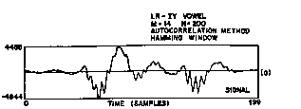
LPC Spectrum

Slide 23
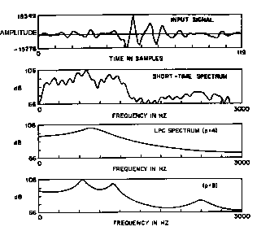
LPC Model Order

Slide 24
Spectral Estimation
Cepstral Analysis
Filter Banks
LPC
Reduced Pitch Effects
X
X
X
Excitation Estimate
X
X
Direct Access to Spectra
X
Less Resolution at HF
X
Orthogonal Outputs
X
Peak-hugging Property
X
Reduced Computation
X

Slide 25
Dynamic Time Warp
Optimal time normalization with dynamic programming
Proposed by Sakoe and Chiba, circa 1970
Similar time, proposal by Itakura
Probably Vintsyuk was first (1968)
Good review article by White, in Trans ASSP April 1976

Slide 26
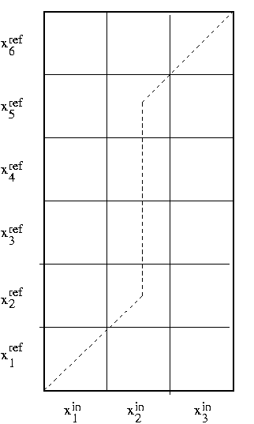
Nonlinear Time Normalization

Slide 27
HMMs for Speech
Math from Baum and others, 1966-1972
Applied to speech by Baker in the original CMU Dragon System (1974)
Developed by IBM (Baker, Jelinek, Bahl, Mercer,….) (1970-1993)
Extended by others in the mid-1980’s

Slide 28
A Hidden Markov Model
q
q
q
1
2
3
P(q | q )
P(q | q )
P(q | q )
2
1
3
2
4
3
P(x | q )
P(x | q )
P(x | q )
1
2
3

Slide 29
Markov model
(state topology)
q
q
1
2
P(x ,x , q ,q ) ≈ P( q ) P(x |q ) P(q | q ) P(x | q )
1
2
1
2
1
1
1
2
1
2
2

Slide 30
Markov model
(graphical form)
q
q
q
q
1
2
3
4
x
x
x
x
1
2
3
4

Slide 31
HMM Training Steps
Initialize estimators and models
Estimate “hidden” variable probabilities
Choose estimator parameters to maximize model likelihoods
Assess and repeat steps as necessary
A special case of Expectation Maximization (EM)

Slide 32
The 1980’s
Collection of large standard corpora
Front ends: auditory models, dynamics
Engineering: scaling to large vocabulary continuous speech
Second major (D)ARPA ASR project
HMMs become ready for prime time

Slide 33
Standard Corpora Collection
Before 1984, chaos
TIMIT
RM (later WSJ)
ATIS
NIST, ARPA, LDC

Slide 34
Front Ends in the 1980’s
Mel cepstrum (Bridle, Mermelstein)
PLP (Hermansky)
Delta cepstrum (Furui)
Auditory models (Seneff, Ghitza, others)

Slide 35
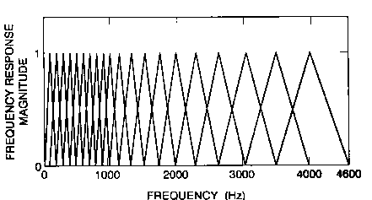
Mel Frequency Scale

Slide 36
Spectral vs Temporal
Processing
frequency
Analysis
(e.g., cepstral)
Spectral processing
Time
Processing
(e.g., mean removal)
frequency
Temporal processing

Slide 37
Dynamic Speech Features
temporal dynamics useful for ASR
local time derivatives of cepstra
“delta’’ features estimated over multiple frames (typically 5)
usually augments static features
can be viewed as a temporal filter

Slide 38
“Delta” impulse response
.2
.1
0
-2
-1
0
1
2
frames
-.1
-.2

Slide 39
HMM’s for Continuous Speech
Using dynamic programming for cts speech (Vintsyuk, Bridle, Sakoe, Ney….)
Application of Baker-Jelinek ideas to continuous speech (IBM, BBN, Philips, ...)
Multiple groups developing major HMM systems (CMU, SRI, Lincoln, BBN, ATT)
Engineering development - coping with data, fast computers

Slide 40
2nd (D)ARPA Project
Common task
Frequent evaluations
Convergence to good, but similar, systems
Lots of engineering development - now up to 60,000 word recognition, in real time, on a workstation, with less than 10% word error
Competition inspired others not in project - Cambridge did HTK, now widely distributed

Slide 41
Knowledge vs. Ignorance
Using acoustic-phonetic knowledge in explicit rules
Ignorance represented statistically
Ignorance-based approaches (HMMs) “won”, but
Knowledge (e.g., segments) becoming statistical
Statistics incorporating knowledge

Slide 42
Some 1990’s Issues
Independence to long-term spectrum
Adaptation
Effects of spontaneous speech
Information retrieval/extraction with broadcast material
Query-style/dialog systems (e.g., ATIS, Voyager, BeRP)
Applying ASR technology to related areas (language ID, speaker verification)

Slide 43
The Berkeley Restaurant Project
(BeRP)

Slide 44
1991-1996 ASR
MFCC/PLP/derivatives widely used
Vocal tract length normalization (VTLN)
Cepstral Mean Subtraction (CMS) or
RelAtive SpecTral Analysis (RASTA)
Continuous density HMMs, w/GMMs or ANNs
N-phones, decision-tree clustering
MLLR unsupervised adaptation
Multiple passes via lattices, esp. for longer term language models (LMs)

Slide 45
“Towards increasing speech recognition error rates”
May 1996 Speech Communication paper
Pointed out that high risk research choices would typically hurt performance (at first)
Encourage researchers to press on
Suggested particular directions
Many comments from other researchers, e.g.,
There are very many bad ideas, and it’s still good to do better (you like better scores too)
You don’t have the only good ideas

Slide 46
What we thought:
We should look at “more time” (than 20 ms)
We should look at better stat models (weaken conditional independence assumptions)
We should look at smaller chunks of the spectrum and combine information later
We should work on improving models of confidence/rejection (knowing when we do not know)

Slide 47
How did we do?
Best systems look at 100 ms or more
Stat models being explored, but HMM still king
Multiband still has limited application, but multiple streams/models/cross-adaptation are widely used
Real systems depend heavily on confidence measures; research systems use for combining

Slide 48
The Question Man
Queried 3 of the best known system builders for today’s large ASR engines: “In your opinion, what have been the most important advances in ASR in the last 10 years?” [asked in late 2006]

Slide 49
Major advances in mainstream systems since 1996- experts 1+2
Front end per se (e.g., adding in PLP)
Normalization (VTLN, mean & variance)
Adaptation/feature transformation (MLLR, HLDA, fMPE)
Discriminative training (MMI, MPE)
Improved n-gram smoothing, other LMs
Handling lots of data (e.g., lower quality transcripts, broader context)
Combining systems (e.g., confusion networks or “sausages”)
Multiple passes using lattices, etc.
Optimizing for speed

Slide 50
Major advances in mainstream systems since 1996- expert 3
Training w/ Canonicalized features:
feature space MLLR, VTLN, SAT
Discriminative features:
feature-space MPE, LDA+MLLT instead of ∆ and ∆ ∆
Essentially no improvement in LMs
Discriminative training (MMI, MPE) effects are duplicated by f-MPE, little or no improvement to do both
Bottom line: better systems by “feeding better features into the machinery”

Slide 51
What is an “important advance”?
Definition assumed by the experts I queried: ideas that made systems work (significantly) better
A broader definition: ideas that led to significant improvements either by themselves or through stimulation of related research
Also: include promising directions?

Slide 52
Major directions since 1991- my view
Front end - PLP, ANN-based features, many others, and (most importantly) multiple streams of features
Normalization – mean & variance, VTLN, RASTA
Adaptation/feature transformation
Discriminative training - I would add ANN trainings
Effects of spontaneous speech - very important!
Handling lots of data
Combining systems or subsystems
New frameworks that could encourage innovation (e.g., graphical models, FSMs)
Optimizing for speed - including hardware

Slide 53
Also - “Beyond the Words” (Pointed out by expert #1)
Hidden events
sentence boundaries
punctuation
diarization (who spoke when)
Dialog Acts
Emotion
Prosodic modeling for all of the above

Slide 54
Major advances since the survey
The resurrection of neural networks
Gradual adoption of NNLMs (just as an assist)
Bigger effect in acoustic modeling – “deep” approaches
Some newer advances in “front ends”, including multi-mic (as in iphones)
Rapid porting/cross lingual
Lots more computing! Lots more data!
Many more applications (e.g., Siri)
Many more users, jobs, interest

Slide 55
Where Pierce Letter Applies
We still need science
Need language, intelligence
Acoustic robustness still poor
Perceptual research, models
Fundamentals of statistical pattern recognition for sequences
Robustness to accent, stress, rate of speech, ……..

Slide 56
Progress in 30 Years
From digits to 60,000 words or more
From single speakers to many
From isolated words to continuous speech
From read speech to fluent speech
From no products to many products, some systems actually saving LOTS of money

Slide 57
Real Uses
Telephone: phone company services (collect versus credit card)
Telephone: call centers for query information (e.g., stock quotes, parcel tracking, 800-GOOG-411)
Dictation products: continuous recognition, speaker dependent/adaptive

Slide 58
But:
Still <97% accurate on “yes” for telephone
Unexpected rate of speech hurts
Performance in noise, reverb still bad
Unexpected accent hurts badly
Accuracy on unrestricted speech at 50-70%
Don’t know when we know
Few advances in basic understanding
Time, resources for each new task, language

Slide 59
Confusion Matrix for Digit Recognition (~1996)
Class
1
2
3
4
5
6
7
8
9
0
Error Rate
1
191
0
0
5
1
0
1
0
2
0
4.5
2
0
188
2
0
0
1
3
0
0
6
6.0
3
0
3
191
0
1
0
2
0
3
0
4.5
4
8
0
0
187
4
0
1
0
0
0
6.5
5
0
0
0
0
193
0
0
0
7
0
3.5
6
0
0
0
0
1
196
0
2
0
1
2.0
7
2
2
0
2
0
1
190
0
1
2
5.0
8
0
1
0
0
1
2
2
196
0
0
2.0
9
5
0
2
0
8
0
3
0
179
3
10.5
0
1
4
0
0
0
1
1
0
1
192
4.5
Overall error rate 4.85%

Slide 60
Dealing with the real world
(also ~1996)
Account number:
Counting
“Marco Polo”
Dialog

Slide 61
Large Vocabulary CSR
Error Rate %
12
•
9
•
Ø
1
6
•
3
•
‘88
‘89
‘90
‘91
‘92
‘93
‘94
Year
--- RM ( 1K words, PP 60)
___ WSJØ, WSJ1 (5K, 20-60K words, PP 100)
~ ~
~ ~

Slide 62
Large Vocabulary CSR
Error Rate %
12
•
9
•
•
Ø
1
6
•
3
•
‘88
‘89
‘90
‘91
‘92
‘93
‘94
Year
--- RM ( 1K words, PP 60)
___ WSJØ, WSJ1 (5K, 20-60K words, PP 100)
~ ~
~ ~

Slide 63
Why is ASR Hard?
Natural speech is continuous
Natural speech has disfluencies
Natural speech is variable over: global rate, local rate, pronunciation within speaker, pronunciation across speakers, phonemes in different contexts

Slide 64
Why is ASR Hard? (continued)
Large vocabularies are confusable
Out of vocabulary words inevitable
Recorded speech is variable over: room acoustics, channel characteristics, background noise
Large training times are not practical
User expectations are for equal to or greater than “human performance”

Slide 65
Main Causes of Speech Variability
Speech - correlated noise reverberation, reflection
Uncorrelated noise additive noise (stationary, nonstationary)
Environment
Attributes of speakers dialect, gender, age
Speaker
Manner of speaking breath & lip noise stress Lombard effect rate level pitch cooperativeness
Input Equipment
Microphone (Transmitter)
Distance from microphone
Filter
Transmission system distortion, noise, echo
Recording equipment

Slide 66
ASR Dimensions
Speaker dependent, independent
Isolated, continuous, keywords
Lexicon size and difficulty
Task constraints, perplexity
Adverse or easy conditions
Natural or read speech

Slide 67
Telephone Speech
Limited bandwidth (F vs S)
Large speaker variability
Large noise variability
Channel distortion
Different handset microphones
Mobile and handsfree acoustics

Slide 68
Sample domain: alphabet
E set: B C D G P T V Z
A set: J K
EH set: M N F S
AH set: I Y R
Difficult even though it is small

Slide 69
Some improvements
Lots of Engineering
+ Moore’s Law
+ promising directions
The basics
Something
works
ASR Prehistory
~1920
~1952
~1976
~1991
2014
What will happen in the “ultraviolet” period?
Or, actually,
What should happen in the “ultraviolet” period?

Slide 70
What’s likely to help
The obvious: faster computers, more memory and disk, more data
Improved techniques for learning from unlabeled data
Serious efforts to handle:
noise and reverb
speaking style variation
out-of-vocabulary words (and sounds)
Learning how to select features
Learning how to select models
Feedback from downstream processing

Slide 71
Also
New (multiple) features and models
Including “deep” approaches
New statistical dependencies (e.g., graphical models)
Multiple time scales
Multiple (larger) sound units
Dynamic/robust pronunciation models
Language models including structure (still!)
Incorporating prosody
Incorporating meaning
Non-speech modalities
Understanding confidence

Slide 72
Automatic Speech Recognition
Data Collection
Pre-processing
Feature Extraction
Hypothesis Generation
Cost Estimator
Decoding

Slide 73
Data Collection + Pre-processing
Speech
Room Acoustics
Linear Filtering
Sampling &
Digitization
Microphone
Issue: Effect on modeling

Slide 74
Feature Extraction
Spectral Analysis
Auditory Model/ Normalizations
Issue: Design for discrimination

Slide 75
Representations are Important
Network
Speech waveform
23% frame correct
Network
PLP features
70% frame correct

Slide 76
Hypothesis Generation
cat
dog
a cat not is adog
a dog is not a cat
Issue: models of language and task

Slide 77
Cost Estimation
Distances
Negative Log probabilities, from
discrete distributions
Gaussians, mixtures
neural networks

Slide 78
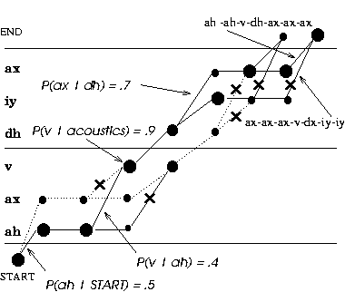
Decoding

Slide 79
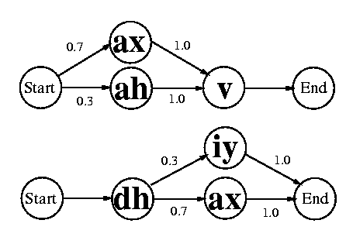
Pronunciation Models

Slide 80
Language Models
Most likely words for largest product
P(acoustics|words) X P(words)
P(words) = Π P(words|history)
bigram, history is previous word
trigram, history is previous 2 words
n-gram, history is previous n-1 words

Slide 81
System Architecture
Grammar
Cepstrum
Probabilities “z” -0.81 “th” = 0.15 “t” = 0.03
Recognized Words
“zero”
“three”
“two”
Decoder
Speech
Signal
Signal Processing
Probability Estimator
Pronunciation
Lexicon

Slide 82
What’s Hot in Research
Speech in noisy environments – Aurora, “RATS”
Portable (e.g., cellular) ASR, assistants (Siri etc)
Trans-/multi- lingual conversational speech (EARS->GALE->BOLT,BABEL)
Shallow understanding of deep speech
Question answering/summarization
Understanding meetings – or at least browsing them
Voice/keyword search
Multimodal/Multimedia

Slide 83
21st Century
ASR Research
New (multiple) features and models
More to learn from the brain?
Deep learning approaches
New statistical dependencies
Learning what’s important
Multiple time scales
Multiple (larger) sound units (segments?)
Dynamic/robust pronunciation models
Long-range language models
Incorporating prosody
Incorporating meaning
Non-speech modalities
Understanding confidence

Slide 84
Summary
Current ASR based on 60 years of research
Core algorithms -> products, 10-30 yrs
Deeply difficult, but tasks can be chosen that are easier in SOME dimension
Much more yet to do, but
Much can be done with current technology

