Slide 1
Deep Learning and its applications to Speech
EE 225D - Audio Signal Processing in Humans and Machines
Oriol Vinyals
UC Berkeley

Slide 2
Disclaimer
This is my biased view about deep learning and, more generally, machine learning past and current research!

Slide 3
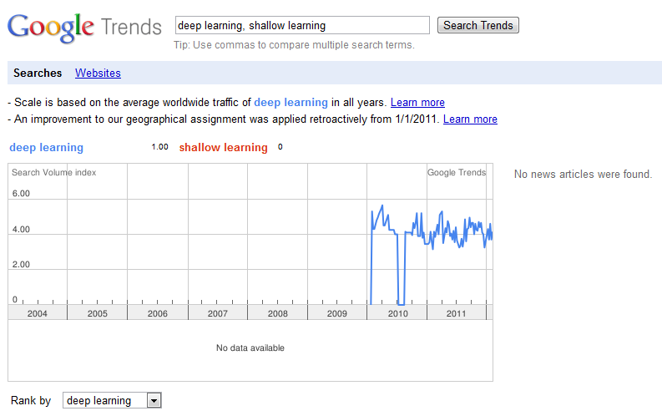
Why this talk?
It’s a hot topic… isn’t it?
http://deeplearning.net

Slide 4
Let’s step back to a ML formulation
Let x be a signal (or features in machine learning jargon), want to find a function f that maps x to an output y:
  Waveform “x” to sentence “y” (ASR)
  Image “x” to face detection “y” (CV)
  Weather measurements “x” to forecast “y” (…)
Machine learning approach:
  Get as many (x,y) pairs as possible, and find f minimizing some loss over the training pairs
    Supervised
    Unsupervised

Slide 5
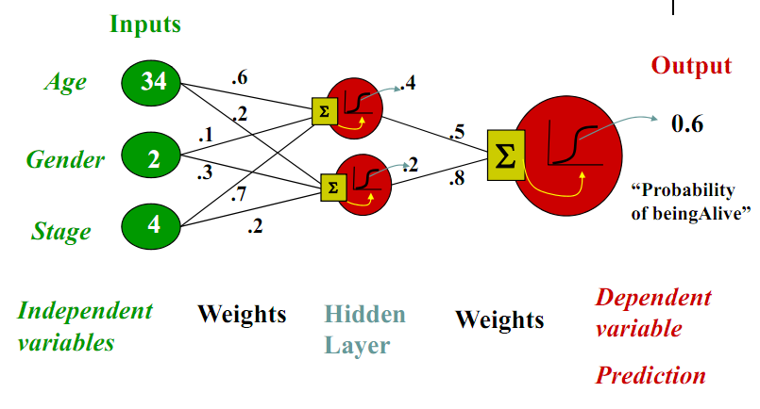
NN
(slide credit: Eric Xing, CMU)

Slide 6
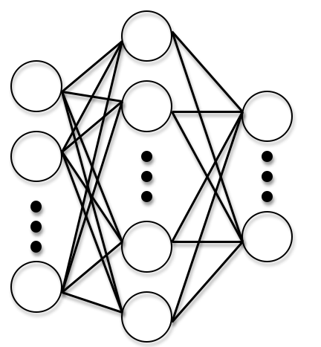
Can’t we do everything with NNs?
Universal approximation thm.:
  We can approximate any (continuous) function on a compact set with a single hidden neural network

Slide 7
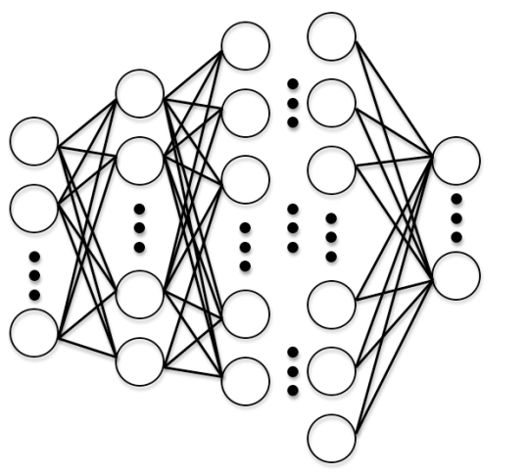
Deep Learning
It has two (possibly more) meanings:
  Use many layers in a NN
  Train each layer in an unsupervised fashion
G. Hinton (U. of T.) et al made these two ideas famous in his 2006 Science paper.

Slide 8
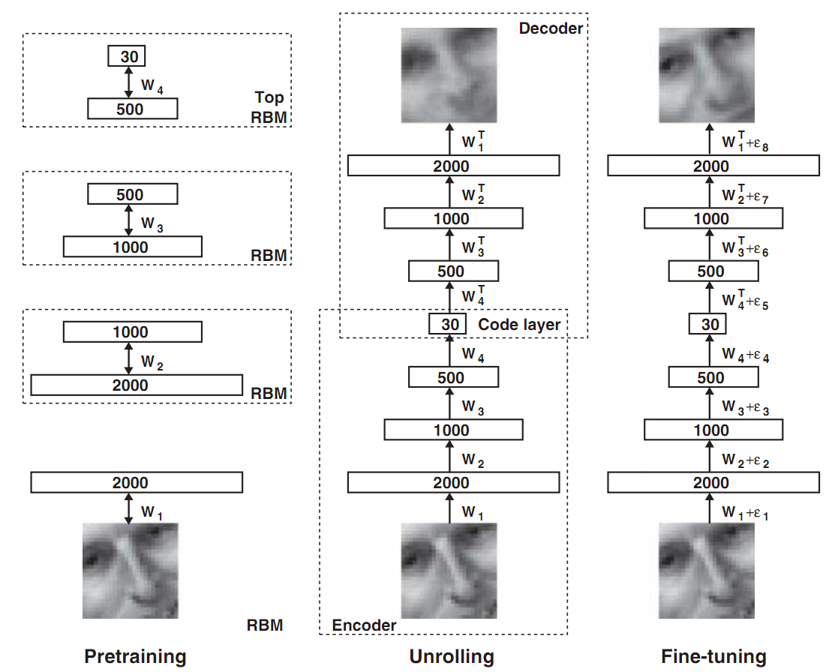
2006 Science paper (G. Hinton et al)

Slide 9
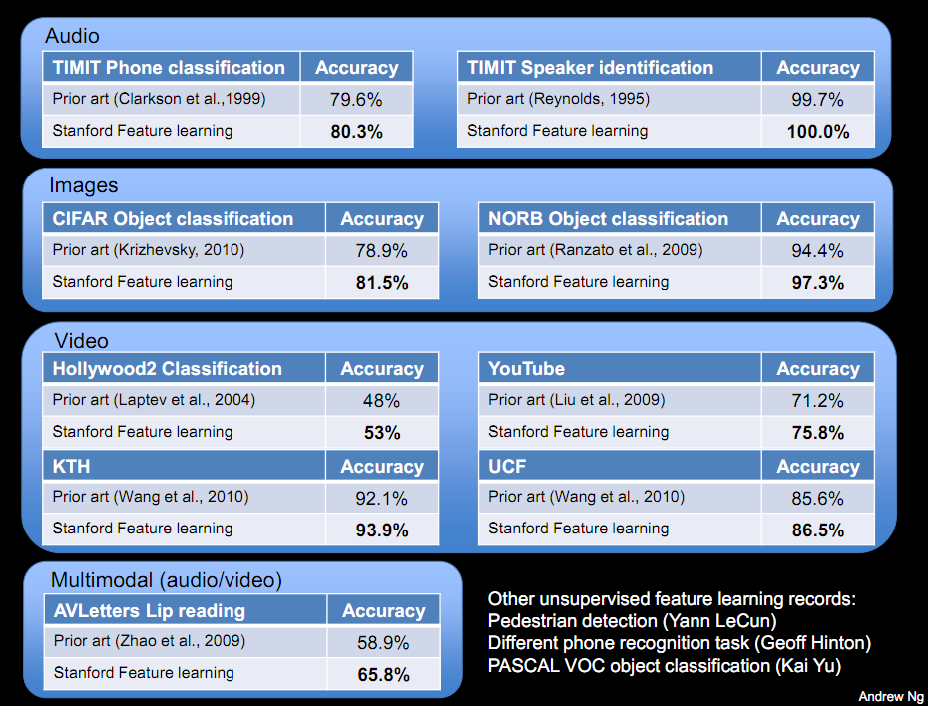
Great results using Deep Learning

Slide 10
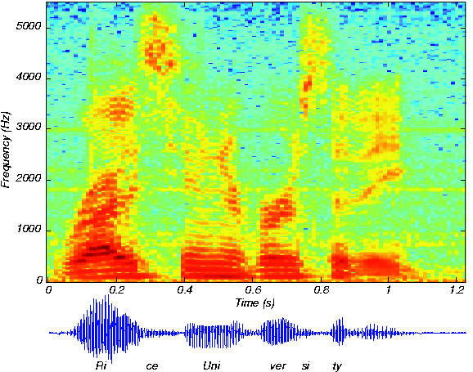
Deep Learning in Speech
Phone
probabilities
HMM
Feature
extraction

Slide 11
Some interesting ASR results
Small scale (TIMIT)
  Many papers, most recent:
  [Deng et al, Interspeech11]
Small scale (Aurora)
  50% rel. impr. [Vinyals et al, ICASSP11/12]
~Med/Lg scale (Switchboard)
  30% rel. impr. [Seide et al, Interspeech11]
… more to come

Slide 12
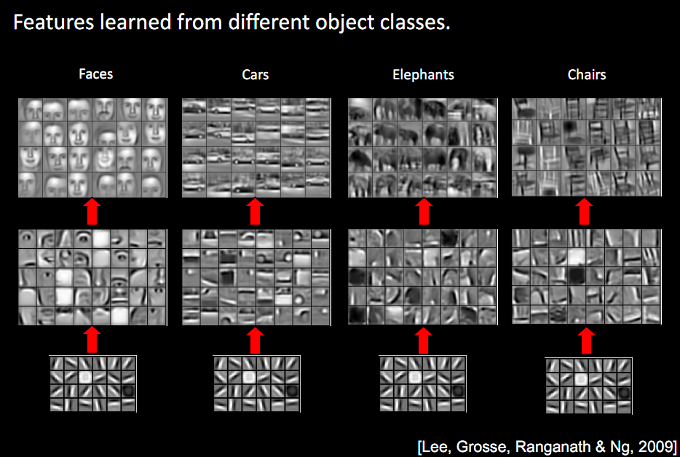
Why is deep better?
Model strength vs. generalization error
Deep architectures: more parameters more efficiently… Why?

Slide 13
Is this how the brain really works?
Most relevant work by B. Olshausen (1997!)
“Sparse Coding with an Overcomplete Basis Set: A Strategy Employed by V1?”
Take a bunch of random natural images, do unsupervised learning, you recover filters that look exactly the same as V1!

Slide 14
Criticisms/open questions
People knew about NN for very long, why the hype now?
  Computational power?
  More data available?
  Connection with neuroscience?
Can we computationally emulate a brain?
  ~10^11 neurons, ~10^15 connections
    Biggest NN: ~10^4 neurons, ~10^8 connections
  Many connections flow backwards
  Brain understanding is far from complete

Slide 15
Questions?

