Slide 1
Experiments in Deep Learning Scaling:
It is Predictable, Empirically
Joel Hestness
Senior Research Scientist
joel@cerebras.net
Friday, Oct. 25, 2019

Slide 2
About Me
Recently moved from Baidu Research to Cerebras Systems
Background in heterogeneous system design and applications
Deep learning research over the last 3.5 years
  Mostly language and time-series applications, and learning theory

Slide 3
Overview
Deep Learning Scaling is Predictable, Empirically
  Model error improves as a power-law with data size
  Model size (capacity) required to fit data increases sublinearly
Can predict necessary data, computation
Generalization Error Theory Overview
Experiments: Decomposing Learning Curves
Notes:
[_] TODO: UPDATE ME!

Slide 4
Deep Learning Scaling is Predictable, Empirically
Learning Curves of Real Applications
Scaling Accuracy Scaling Compute The Math More Experiments
Notes:
This study tested 7 different deep learning models on 5 different DL domains
We used approximately 50 GPU years worth of compute

Slide 5
Motivation
We have a few clear mechanisms for improving modeling
Search for new models of our data
Find better learning algorithms, optimization
Increase data set size and train larger models
Changing models/learning algorithms/optimization is complicated
Requires creative reframing of the problem
Results are tough to predict

Slide 6
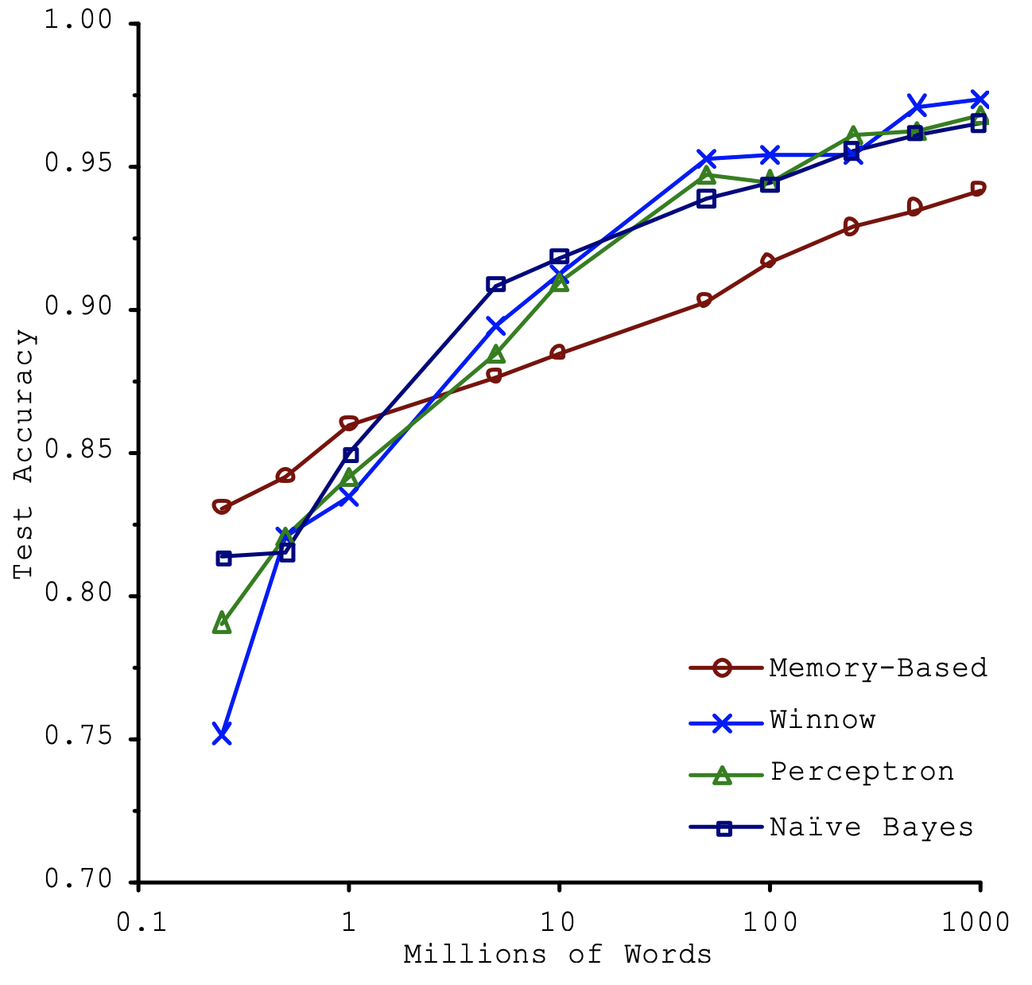
Prior work: More data, more accuracy
Learning curves
The change in generalization accuracy with additional data
Consistent improvement with more data!
Rank of models changes with different data size!
Banko and Brill, Scaling to Very Very Large Corpora for Natural Language Disambiguation, ACL 2001

Slide 7
Hypotheses
Maybe all applications have same, similar trends?
Maybe all models?
Surely, we must be able to do better?

Slide 8
Preview of Results
Learning curves have 3 phases
Best-guessing (small data)
Power-law improvements
Irreducible error
However…
Empirical prediction
Indicates “difficulty” to improve deep learning accuracy
Hestness et al., Deep Learning Scaling is Predictable, Empirically, ArXiv 2017, https://arxiv.org/abs/1712.00409

Slide 9
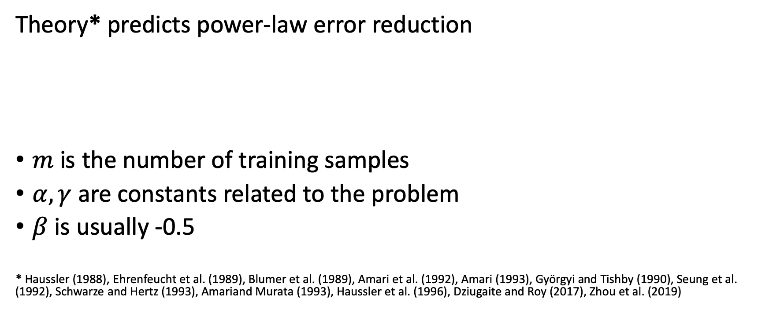
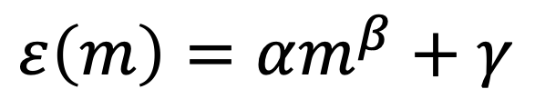
How should accuracy scale with data?
Theory* predicts power-law error reduction
$m$ is the number of training samples
$α, γ$ are constants related to the problem
$β$ is usually -0.5
* Haussler (1988), Ehrenfeucht et al. (1989), Blumer et al. (1989), Amari et al. (1992), Amari (1993), Györgyi and Tishby (1990), Seung et al. (1992), Schwarze and Hertz (1993), Amariand Murata (1993), Haussler et al. (1996), Dziugaite and Roy (2017), Zhou et al. (2019)
$$ε\left(m\right)=αm^{β}+γ$$

Slide 10
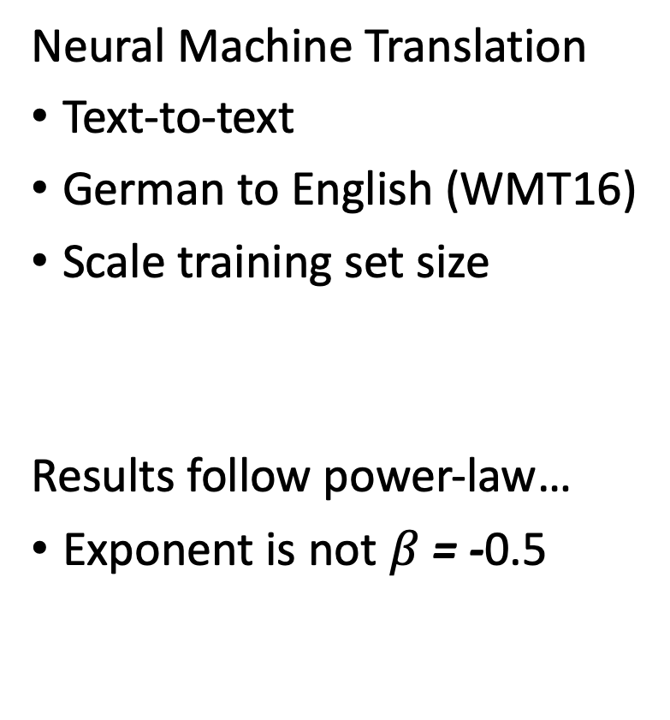
How does accuracy scale with data?
Neural Machine Translation
Text-to-text
German to English (WMT16)
Scale training set size
Results follow power-law…
Exponent is not $β$ = -0.5
Notes:
Neural Machine Translation

Slide 11
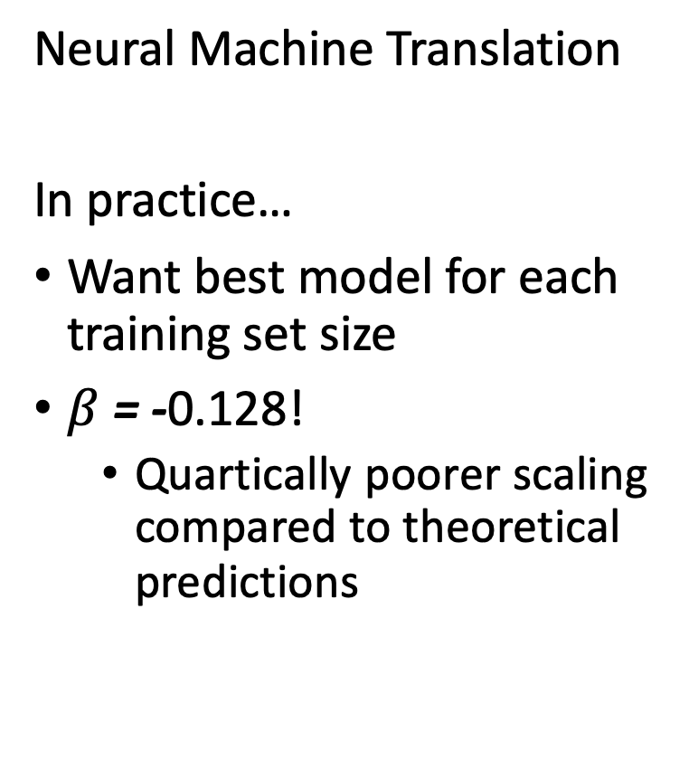
Best-fit learning curve
Neural Machine Translation
In practice…
Want best model for each training set size
$β$ = -0.128!
  Quartically poorer scaling compared to theoretical predictions
Notes:
Neural Machine Translation

Slide 12
Best-fit learning curves
Word Language Models
Char Language Models
Notes:
Word language models
Show the power-law error reduction
Here, we tested 2 different model architectures, Long-Short Term Memory models and Recurrent Highway Networks
The deeper LSTM model performs worse than the shallower LSTM and the RHN networks
Surprisingly, these different models show the same power-law exponent---they learn at the same pace when adding more data
Character language models
Also show power-law error reduction
Here, we tested 2 different optimizers, standard Stochastic Gradient Descent and the Adam Optimizer, training Recurrent Highway Networks
Adam improves the error proportionally at each training set size
Surprisingly, the power-law exponent is still the same between these two optimizers

Slide 13
Best-fit learning curves
Speech Recognition
Image Classification
Notes:
Speech recognition models
Show the power-law error reduction
Here, we tested 2 different model architectures, DeepSpeech 2 models and Attention-based models
Different models show the same power-law exponent---they learn at the same pace when adding more data
Image classification
Also show power-law error reduction
Here, we tested ResNet models on ImageNet data sets
Test multiple different loss functions, Top-1 classification error, Top-5, and cross-entropy
All show power-law characteristics after the training set grows beyond about 25 images per class

Slide 14
Real Application Learning Curves
Power-law region
Usually less steep than theoretical
Model changes only shift the curve
Optimizers only shift the curve
Exponent indicates the “difficulty” of the problems

Slide 15
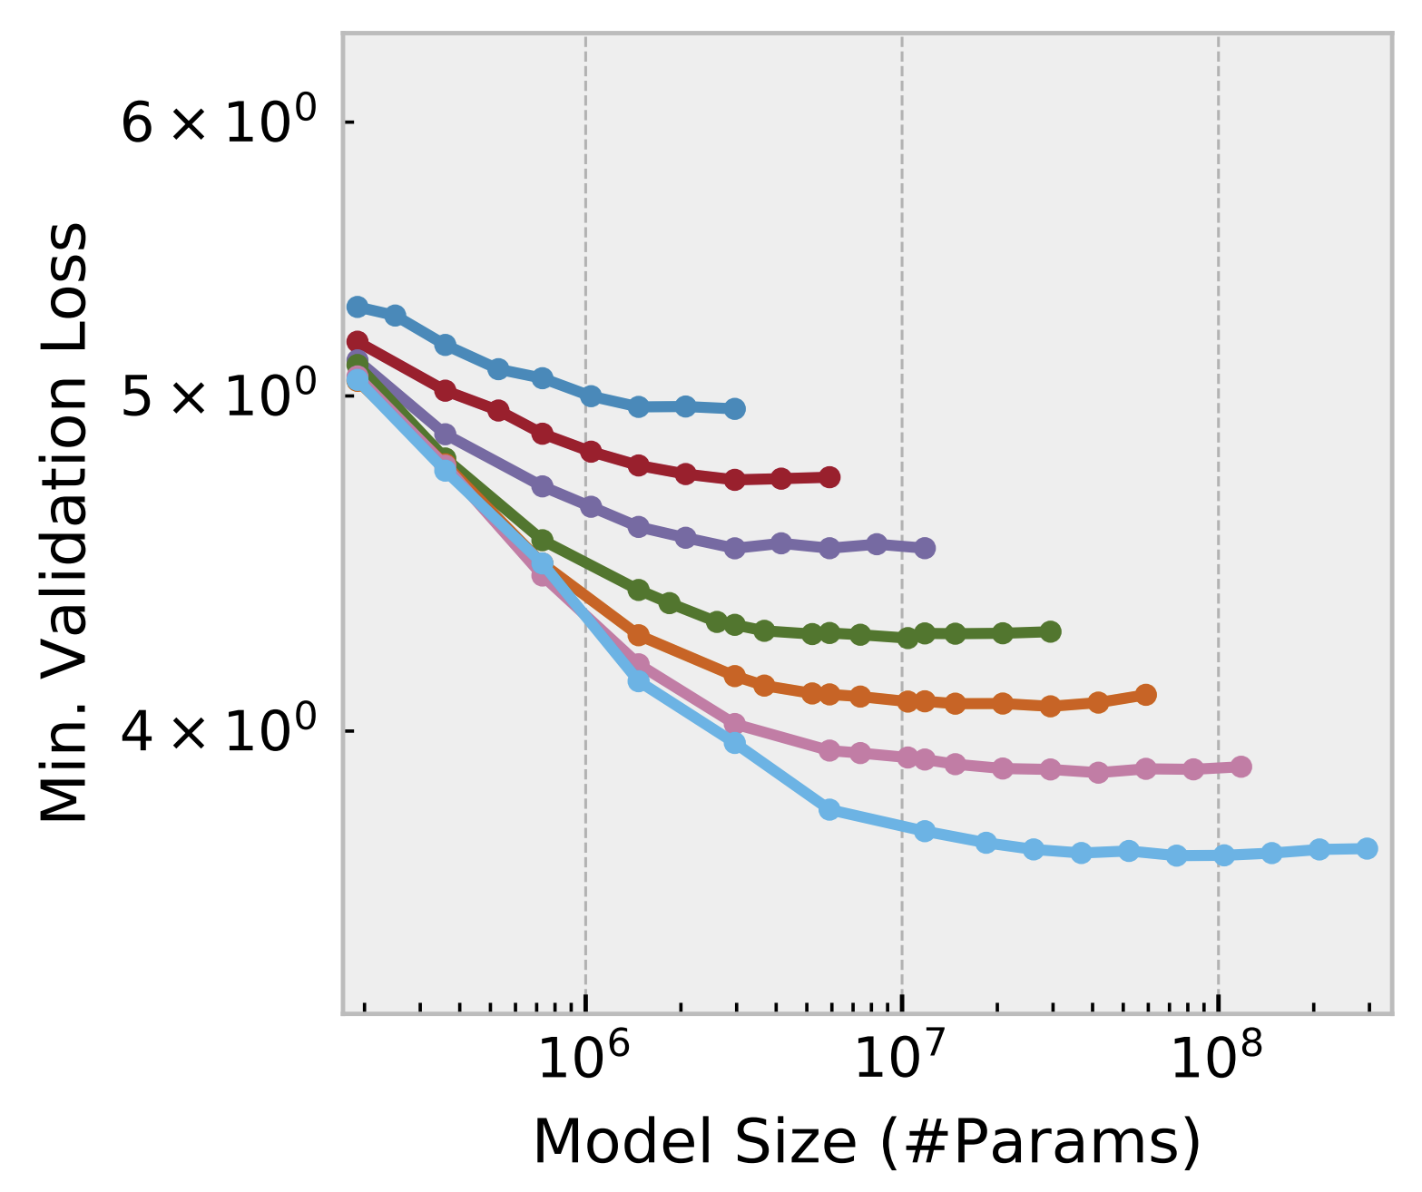
Finding Best-fit Model Size for a Dataset
Finite dataset = finite information
Model with “sufficient capacity” will fit
Increase dataset size requires a larger model
0.1% of data
0.2%
0.4%
1%
2%
4%
10%
Ardalani, Hestness, Diamos, Have a Larger Cake and Eat it Too: A Guideline to Train Larger Models Faster, SysML 2018
Word Language Modeling

Slide 16
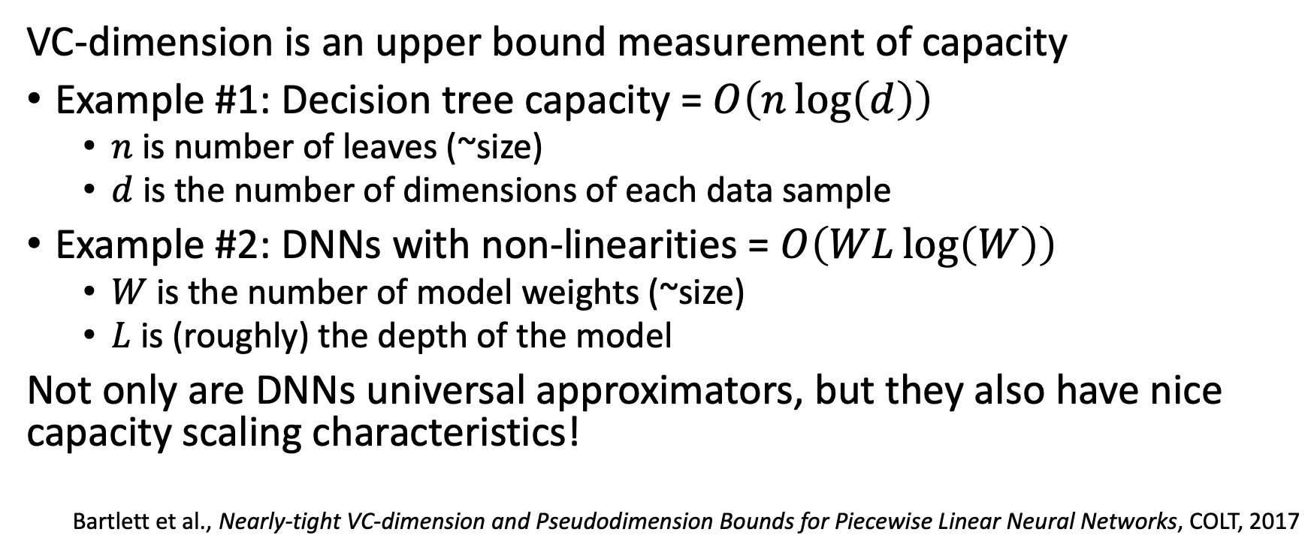
Model Capacity (VC-Dimension)
VC-dimension is an upper bound measurement of capacity
Example #1: Decision tree capacity = $O\left(n\log\left(d\right)\right)$
  $n$ is number of leaves (~size)
  $d$ is the number of dimensions of each data sample
Example #2: DNNs with non-linearities = $O\left(WL\log\left(W\right)\right)$
  $W$ is the number of model weights (~size)
  $L$ is (roughly) the depth of the model
Not only are DNNs universal approximators, but they also have nice capacity scaling characteristics!
Bartlett et al., Nearly-tight VC-dimension and Pseudodimension Bounds for Piecewise Linear Neural Networks, COLT, 2017

Slide 17
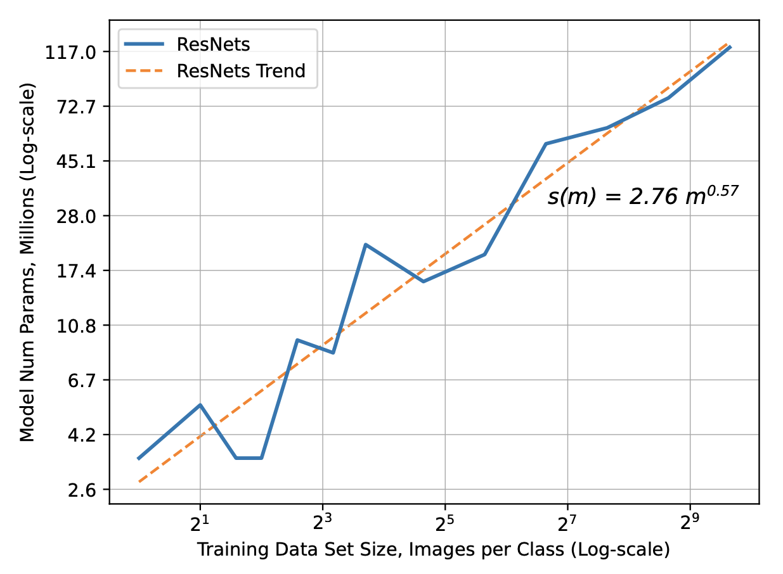
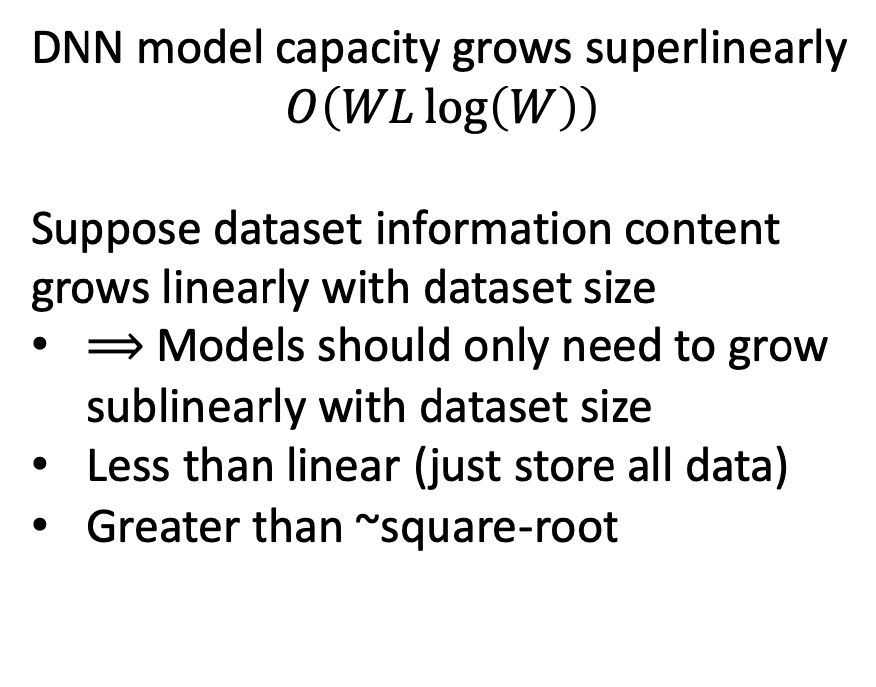
Best-fit Model Size for Dataset Size
DNN model capacity grows superlinearly
$$O\left(WL\log\left(W\right)\right)$$
Suppose dataset information content grows linearly with dataset size
⟹ Models should only need to grow sublinearly with dataset size
Less than linear (just store all data)
Greater than ~square-root

Slide 18
Computational Requirements of Deep Learning
Predicting “Difficulty” to Train Models at Scale
Scaling Accuracy Scaling Compute The Math More Experiments
Notes:
This study tested 7 different deep learning models on 5 different DL domains
We used approximately 50 GPU years worth of compute

Slide 19
Larger Data and Models
Larger data sets
Community already training 1TB+ data sets
Train time grows linearly in data set
Larger models
Google wants 1T parameter models (~300x)*
  *Shazeer et al., Outrageously Large Neural Networks: The Sparsely-Gated Mixture-of-Experts Layer, 2017
Train step time grows linearly with model

Slide 20
Case Study: “Just Data” Scaling
We can predict how much data we want…
Word language models
Current SOTA: 29 perplexity on 4GB data
Projected: 12 perplexity on 400GB data
  >2.4x relative improvement (1.4x nats/word) with 100x data

Slide 21
Power-law Region: Now we’re scaling!
Data costs
If we have $/sample or time-to-collect/sample: Estimate accuracy
  Example:
    Labeling objects in image with Mechanical Turk (~$0.10 per image)
    Say we know we need 10M images… Maybe need to spend $1M on data
Public datasets for pre-training
  Start with ImageNet (1.3M images = ~$130k)
Unlabeled vs. Labeled data: Autoencoders + fine-tuning
Notes:
We know that each new sample gives us better accuracy

Slide 22
Power-law Region: Now we’re scaling!
Compute requirements
Hyperparameter search (embarrassingly parallel)
  Train many models concurrently to find the best-fit
Compute operations scale ~linearly with parameter count
Training steps scale ~linearly with dataset size
Model size grows sublinearly with dataset size
→ Compute time grows ≤ square(dataset growth)
Hestness et al., Beyond Human-level Accuracy: Computational Challenges in Deep Learning, https://dl.acm.org/citation.cfm?id=3295710

Slide 23
Real Application “Accuracy Costs”
Domain | Current SOTA | Power-law Exponent | Desired Improvement | Required Data | Accuracy (Data) Costs
Word Language Models | 29 PPL | -0.066 | 1.4x | 100x | Low
Character Language Models | 1.30 bits/char | -0.092 | 1.9x | 900x | ~Low
Neural Machine Translation | 28% WPER | -0.128 | 2.0x | 224x | High
Speech Recognition | 9.5% CER | -0.291 | 1.9x | 10x | High
Image Classification | 19.4% Top-1 Error | -0.309 | 3.9x | 80x | Medium

Slide 24
Real Application “Training Difficulty”
Domain | Desired Improvement | Required Data | Required Model Scale | Training Time: (Assume Linear) | Training Difficulty
Word Language Models | 1.4x | 100x | 23x | 2,300x | Medium
Character Language Models | 1.9x | 900x | 214x | 192,000x | Very Hard
Neural Machine Translation | 2.0x | 224x | 40x | 9,000x | Hard
Speech Recognition | 1.9x | 10x | 4x | 40x | Easy
Image Classification | 3.9x | 80x | 12x | 1,000x | Medium
  Moore’s Law: 2x performance every 1.5-2 years:
  1,000x ⟹ 15-20 years
  192,000x ⟹ 26-35 years
  Conclusion: It might be quicker to wait for the hardware!
~100 yrs.

Slide 25
Learning Curves Help Us…
Predict how much data we might need to get to desired accuracy
  Estimate dataset costs
Can estimate how much larger models need to be
Predict how much compute we might need
  Estimate training time
  Estimate compute costs

Slide 26
Generalization Error
Some Math Behind Learning Curves
Scaling Accuracy Scaling Compute The Math More Experiments

Slide 27
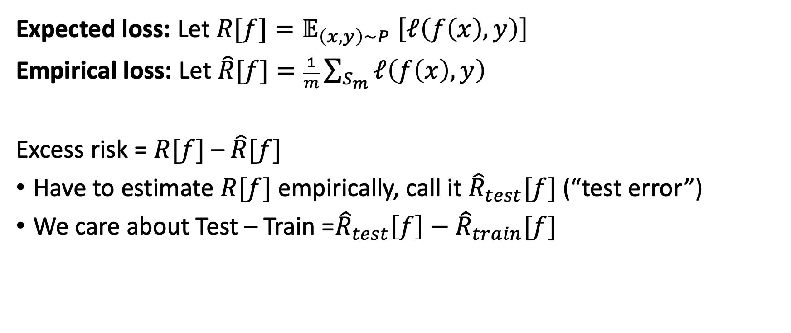
Excess Risk (what we care about)
Expected loss: Let ${R[f]=𝔼}_{\left(x,y\right)\sim P} \left[ℓ\left(f\left(x\right),y\right)\right]$
Empirical loss: Let $\hat{R}[f]=\frac{1}{m}\sum_{S_{m}}{ℓ\left(f\left(x\right),y\right)}$
Excess risk = $R[f]$ – $\hat{R}[f]$
Have to estimate $R[f]$ empirically, call it ${\hat{R}}_{test}[f]$ (“test error”)
We care about Test – Train =${\hat{R}}_{test}\left[f\right]−{\hat{R}}_{train}[f]$

Slide 28
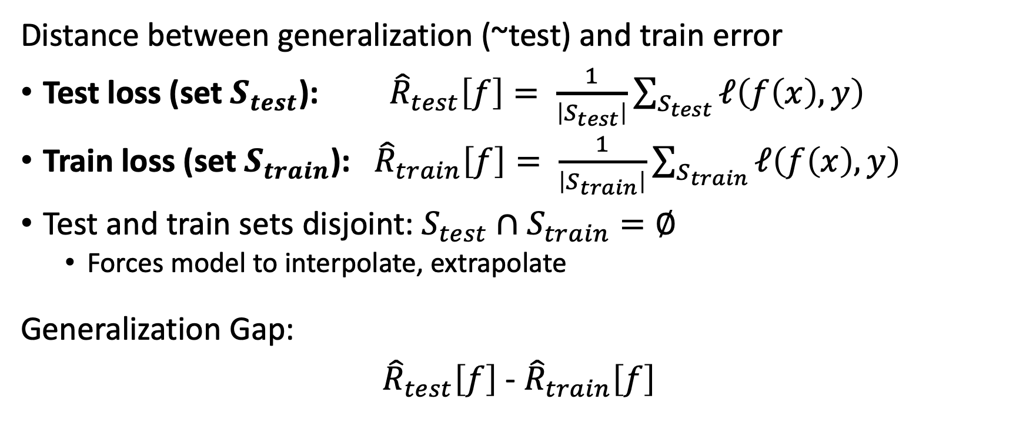
Generalization Gap (what we care about)
Distance between generalization (~test) and train error
Test loss (set $S_{test}$): ${\hat{R}}_{test}\left[f\right]= \frac{1}{\left|S_{test}\right|}\sum_{S_{test}}{ℓ\left(f\left(x\right),y\right)}$
Train loss (set $S_{train}$): ${\hat{R}}_{train}\left[f\right]= \frac{1}{\left|S_{train}\right|}\sum_{S_{train}}{ℓ\left(f\left(x\right),y\right)}$
Test and train sets disjoint: $S_{test}∩S_{train}=∅$
  Forces model to interpolate, extrapolate
Generalization Gap:
${\hat{R}}_{test}\left[f\right]$ - ${\hat{R}}_{train}\left[f\right]$

Slide 29
Training Error…
Consistent Learning Algorithm
Output a model that perfectly fits training data (i.e., train error = 0)
True/False: Training error can always get to 0 with appropriate model
False:
  Training set can contain two data points with same input but different outputs. Any static model will get at least one wrong. Any probabilistic model is probabilistically unlikely to randomly guess correctly.
  On such training sets, even consistent learning algorithms will not return perfect models

Slide 30
Generalization Gap Results: General Form
Theory* predicts power-law error reduction
$m$ is the number of training samples
$α, γ$ are constants related to the problem
$β$ is usually -0.5
* Haussler (1988), Ehrenfeucht et al. (1989), Blumer et al. (1989), Amari et al. (1992), Amari (1993), Györgyi and Tishby (1990), Seung et al. (1992), Schwarze and Hertz (1993), Amariand Murata (1993), Haussler et al. (1996), Dziugaite and Roy (2017), Zhou et al. (2019)
$$ε\left(m\right)=αm^{β}+γ$$

Slide 31
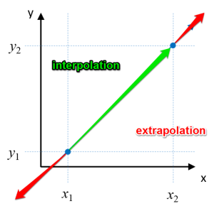
Some Intuition…
A model warps/stretches input space to approximate the output
Interpolates or extrapolates
Some dimensions interpolate, others extrapolate
When doing these, model can use any prior training samples

Slide 32
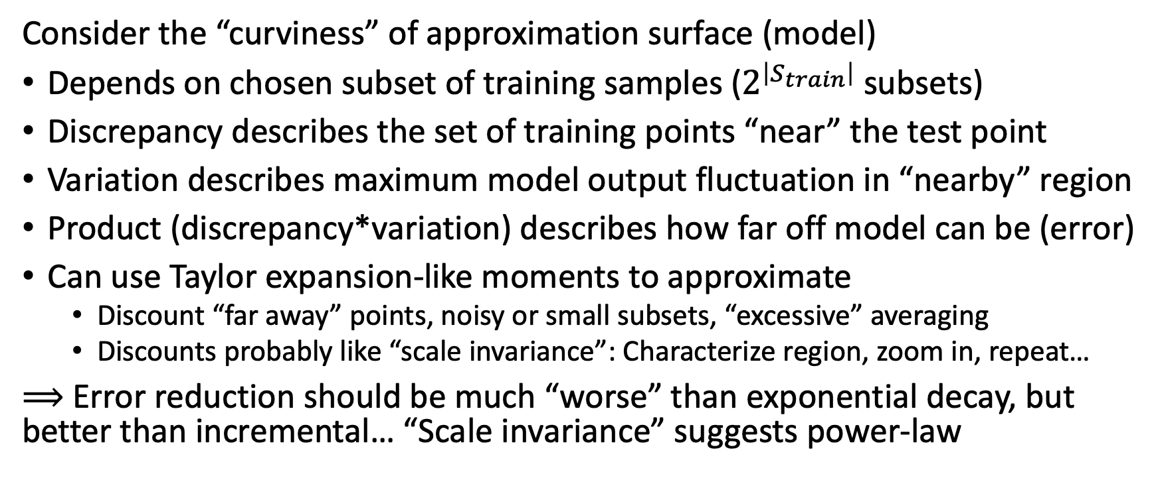
Some Intuition…
Consider the “curviness” of approximation surface (model)
Depends on chosen subset of training samples ($2^{\left|S_{train}\right|}$ subsets)
Discrepancy describes the set of training points “near” the test point
Variation describes maximum model output fluctuation in “nearby” region
Product (discrepancy*variation) describes how far off model can be (error)
Can use Taylor expansion-like moments to approximate
  Discount “far away” points, noisy or small subsets, “excessive” averaging
  Discounts probably like “scale invariance”: Characterize region, zoom in, repeat…
⟹ Error reduction should be much “worse” than exponential decay, but better than incremental… “Scale invariance” suggests power-law
Notes:
Variation is like partial derivatives in each direction (think high-order Newton’s method for approximating value based on comparison with many points)

Slide 33
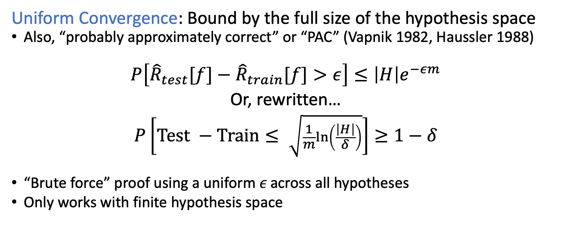
Generalization Bounds: Part I
Uniform Convergence: Bound by the full size of the hypothesis space
Also, “probably approximately correct” or “PAC” (Vapnik 1982, Haussler 1988)
$$P\left[{\hat{R}}_{test}[f]−{\hat{R}}_{train}[f]>ε\right]≤\left|H\right|e^{−εm}$$
Or, rewritten…
$$P\left[\text{Test} −\text{Train}≤ \sqrt{\frac{1}{m}ln⁡\left(\frac{\left|H\right|}{δ}\right)}\right]≥1−δ$$
“Brute force” proof using a uniform 𝜖 across all hypotheses
Only works with finite hypothesis space

Slide 34
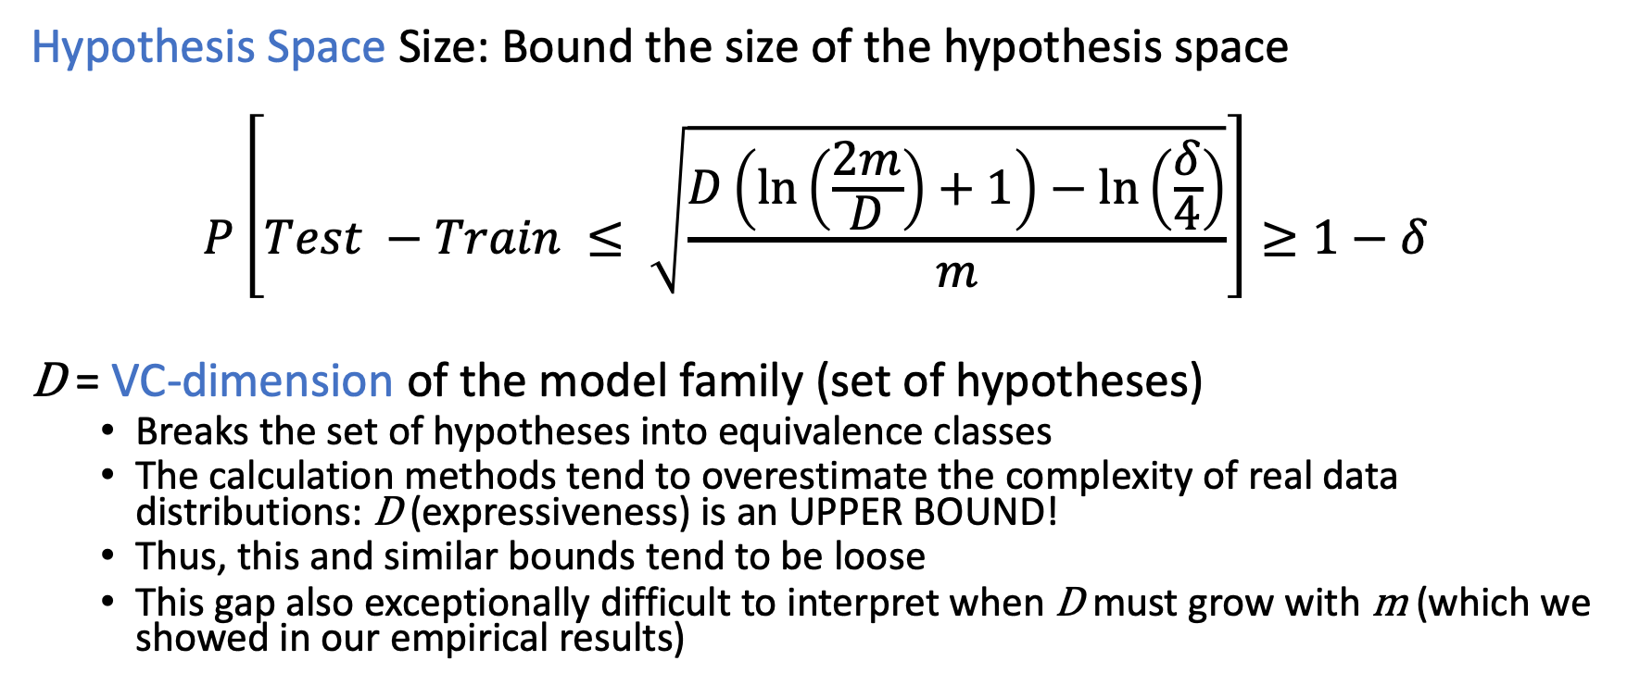
Generalization Bounds: Part II
Hypothesis Space Size: Bound the size of the hypothesis space
$$P\left[Test −Train ≤ \sqrt{\frac{D\left(\ln\left(\frac{2m}{D}\right)+1\right)−\ln\left(\frac{δ}{4}\right)}{m}}\right]≥1−δ$$
D = VC-dimension of the model family (set of hypotheses)
  Breaks the set of hypotheses into equivalence classes
  The calculation methods tend to overestimate the complexity of real data distributions: D (expressiveness) is an UPPER BOUND!
  Thus, this and similar bounds tend to be loose
  This gap also exceptionally difficult to interpret when D must grow with m (which we showed in our empirical results)

Slide 35
Generalization Bounds: Part III
Algorithm Stability: Bound the distance between “valid” hypotheses
Measure of how much a change to the dataset changes the model
Bousquet and Elisseeff, Stability and Generalization, JMLR, 2002, http://www.jmlr.org/papers/volume2/bousquet02a/bousquet02a.pdf
Algorithm Robustness: Bound the loss distance between hypotheses
How much you can change an input without changing the output
Xu and Mannor, Robustness and Generalization, CoML, 2012, https://arxiv.org/abs/1005.2243

Slide 36
Designing and Running Further Experiments
Decomposing Learning Curves
Scaling Accuracy Scaling Compute The Math More Experiments

Slide 37
Preview of Results
Power-law region
Usually less steep than theoretical
Model changes only shift the curve
Optimizers only shift the curve
Opportunity to explain slope!

Slide 38
What affects power-law exponent?
𝜀 (m) = 𝛼 m ^{𝛽} + 𝛾
Prior theoretical works do not consider “real” data factors
Assume static data distributions
Assume perfect visibility of all data features
Assume hypothesis space contains correct model
Notes:
<<Describe prior assumptions>>
We have some evidence that suggests the biggest factor in power-law exponent is the visibility of input data features, so I’ll show some examples here

Slide 39
Experiment #1: Per-timestep Loss
Character LMs:
Timestep i has context length i
Intuition: Easier to predict further into sequence

Slide 40
Experiment #1: Per-timestep Loss
Character LMs:
Timestep i has context length i
Intuition: Easier to predict further into sequence

Slide 41
Experiment #1: Per-timestep Loss
Character LMs:
Timestep i has context length i
Intuition: Easier to predict further into sequence

Slide 42
Experiment #1: Per-timestep Loss
Character LMs:
Timestep i has context length i
Intuition: Easier to predict further into sequence

Slide 43
Experiment #1: Per-timestep Loss
Character LMs:
Timestep i has context length i
Intuition: Easier to predict further into sequence
More context helps!

Slide 44
Experiment #2: N-grams vs. LSTMs
Word LMs:
Radically change the model: N-grams
Intuition: Fuzzy… maybe LSTMs have better exponent?

Slide 45
Experiment #2: N-grams vs. LSTMs
Word LMs:
Radically change the model: N-grams
Intuition: Fuzzy… maybe LSTMs have better exponent?
Constrained input structure hurts!

Slide 46
Experiment #3: Different Data Sets
Word LMs:
Change data characteristics, but keep same context
Intuition: More regular data should be easier to predict

Slide 47
Experiment #3: Different Data Sets
Word LMs:
Change data characteristics, but keep same context
Intuition: More regular data should be easier to predict

Slide 48
Experiment #3: Different Data Sets
Word LMs:
Change data characteristics, but keep same context
Intuition: More regular data should be easier to predict
Data regularity helps!
Notes:
1BW is mostly news articles with good grammar and punctuation.
The information content of each sample in CC is lower: Scraped web pages with structure removed. Poor organization, some not even sentences
Info content of Code samples is likely to be higher: Context-free grammar + comments (plain English)

Slide 49
Experiment #4: Remove input features
Toy Problem (binary):
Same data, but remove features
Intuition: Fewer features = harder to learn

Slide 50
Experiment #4: Remove input features
Toy Problem (binary):
Same data, but remove features
Intuition: Fewer features = harder to learn

Slide 51
Experiment #4: Remove input features
Toy Problem (binary):
Same data, but remove features
Intuition: Fewer features = harder to learn

Slide 52
Experiment #4: Remove input features
Toy Problem (binary):
Same data, but remove features
Intuition: Fewer features = harder to learn

Slide 53
Experiment #4: Remove input features
Toy Problem (binary):
Same data, but remove features
Intuition: Fewer features = harder to learn
More information-containing features help!

Slide 54
Possible Further Experiments
Creating data generators for LMs
  Can control input feature visibility
  Can control Bayes’ (irreducible) error
Aim to theoretically explain the power-law exponent

Slide 55
Summary
Error improves predictably (power-law) with dataset size
Model sizes need to grow sublinearly with dataset size
  You can predict your data costs, compute requirements
Grow model capacity (size) until it fits the data
Generalization Gap: room for more theoretical, empirical study!
Thanks!
Joel Hestness joel@cerebras.net

Slide 57
Backup

Slide 58
Your Data is (Probably) Hierarchical
Results and Biases from Real World Problems
Scaling Accuracy Scaling Compute Hierarchical Data

Slide 59
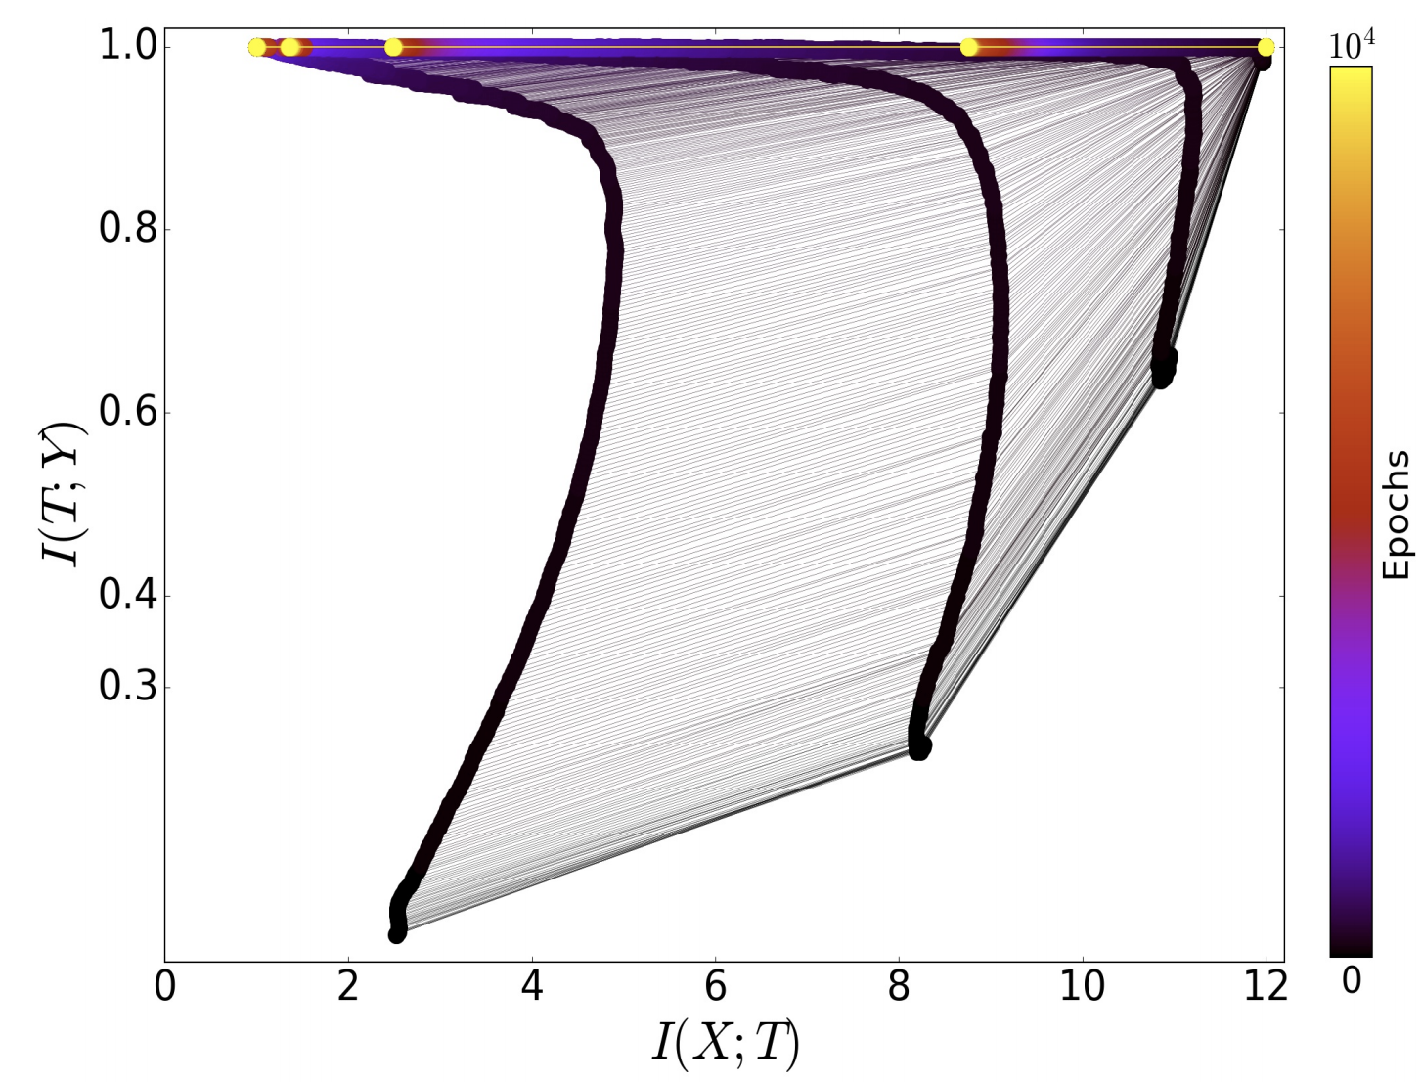
Information Bottleneck → Hierarchy
Early layers of the network share
  Little mutual information with the inputs (i.e., only capturing small bits)
  Much mutual information with the outputs (i.e., small bits are enough to predict outputs!)
Later layers have complete mutual information with inputs!
Schwartz-Ziv and Tishby, Opening the Black Box of Deep Neural Networks via Information, ICRI-CI 2017, https://arxiv.org/pdf/1703.00810.pdf

Slide 60
Inductive bias can be your friend
Baked-in assumptions about how model should reason (hierarchically!)
Example #1: Computer vision should be translationally invariant
  Let’s use convolutions to apply same model to images spatially
Example #2: Language is structured sequentially
  Let’s use models that integrate knowledge sequentially: Recurrent models
Example #3: Human memory is highly-associative
  Let’s use hash maps (key-value stores) to cache knowledge (transformers)
A data structures textbook might be helpful!

Slide 61
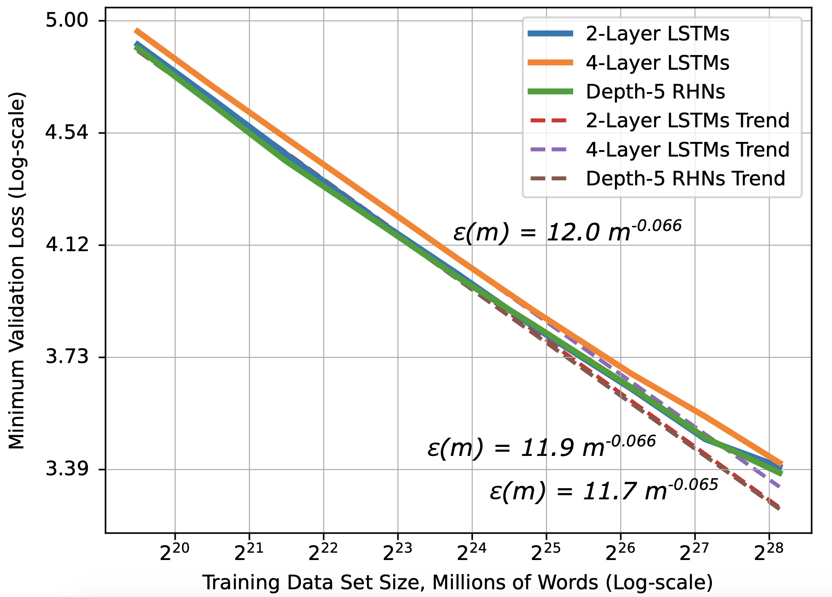
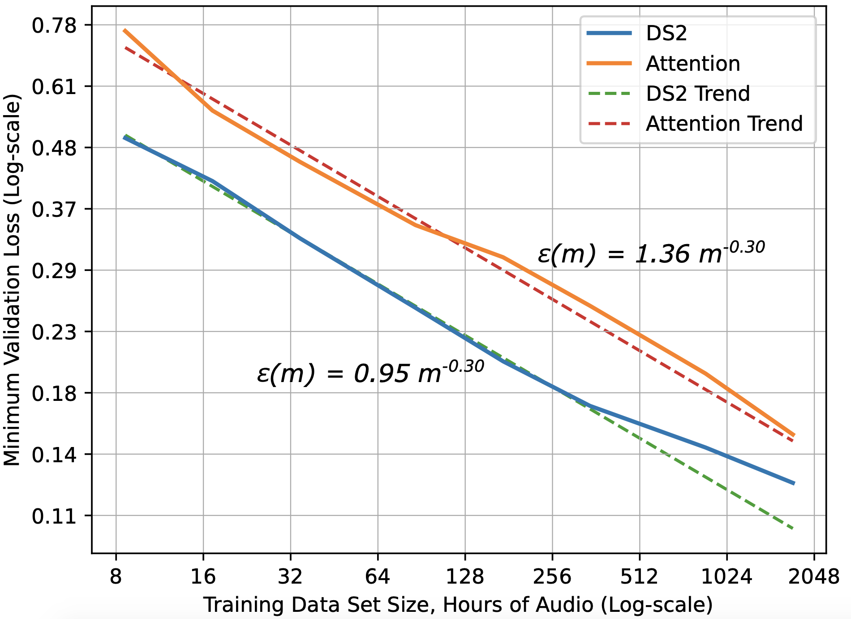
Inductive Bias Affects Learning Curves!
It is “harder” to train attention models…
- Speech recognition experts at Baidu
Notes:
Here, I’m showing the learning curves for multiple different word language models. They all have the same power-law exponents, but the constants are different. The constants can represent a couple things: (1) If everything else was equal, likely due to different inductive biases embedded in the models, (2) more likely difficulty optimizing
Speech models also show same power-law exponent. A major difference here is that DeepSpeech 2 has an independence assumption in the output decoder from one predicted token to the next, while the attention model permits dependences across predicted tokens. It seems this is harder to train, and when you add a language model to assist with decoding, the attention model actually performs better.

Slide 62
Initialization (Prior Bias)
Word embeddings example
  Vocabulary size: 100,000 words
  Embedding dimension: 256 weights
Observation: Most words are not related to most other words
  Would like most embeddings to be orthogonal
  Uniform random weight initialization results in mostly orthogonal!
  Spurious word relationships need to be removed
  256 dimensions only permits 256 orthogonal vectors (bias!)
Advanced mode: Initialize with pre-trained word embeddings

Slide 63
Generalization Error: State-of-the-art
Current Generalization Error Theory Works

Slide 64
Brief Aside: VC-dimension Variants
Definition (alt. example of many): Pseudodimension (Pollard, 1990)
Measure of capacity for functions that map to real numbers
  Alternatively: Measure of the “curviness” of boundaries between classes
Can define output thresholds and map to binary outputs
Anthony and Bartlett, 1999: Pdim(F) = VCdim(F)

Slide 65
Brief Aside: Rademacher Complexity
Definition (alt. measure): Rademacher complexity (Bartlett, 2002)
Estimate model capacity by training on random data distributions
  Alternatively: try to fit very noisy data, characterize how noisy
This is an empirical measure, but also equivalent to VC-dim

Slide 66
Refinements
Dziugaite and Roy, Computing Nonvacuous Generalization Bounds for Deep (Stochastic) Neural Networks with Many More Parameters than Training Data, UAI 2017, https://arxiv.org/abs/1703.11008
Most bounds are vacuous, because VC-dim of large models is huge
  Aside: “Why do deep neural networks generalize?”
  Use stability/robustness/Rademacher ideas to measure the sensitivity of model (weight) changes to the model’s error on a test set
  Turns out clusters of “good” models can populate closely, and the effective dimension of these clusters is significantly smaller than the model’s family
  (This is equivalent to modifying the learning algorithm!)

Slide 67
Generalization Bounds: Latest
Kawaguchi, Bengio, Verma, Kaelbling, Generalization in Machine Learning via Analytical Learning Theory, MIT Technical Report, 2018, https://arxiv.org/abs/1802.07426
Kawaguchi, Kaelbling, Bengio, Generalization in Deep Learning, MoDL, 2019, https://arxiv.org/abs/1710.05468
Like the intuition above, they use (discrepancy * variation) to formulate a generalization gap bound. Same power-law form!

Slide 68
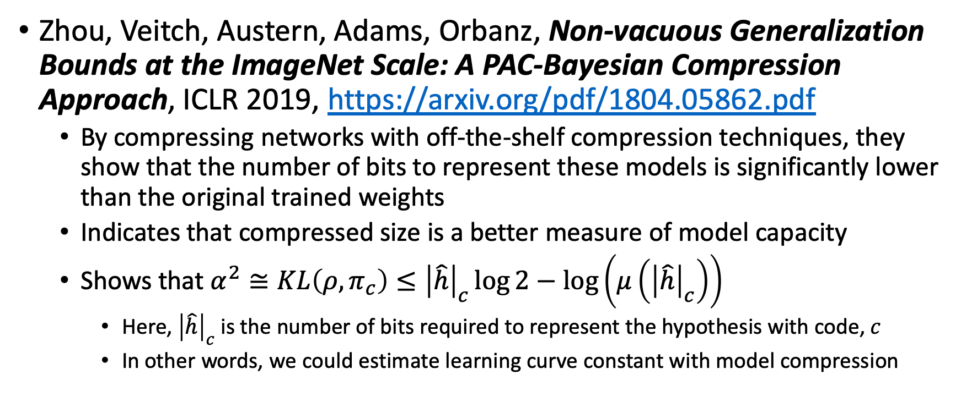
Compressibility is a Proxy for Capacity
Zhou, Veitch, Austern, Adams, Orbanz, Non-vacuous Generalization Bounds at the ImageNet Scale: A PAC-Bayesian Compression Approach, ICLR 2019, https://arxiv.org/pdf/1804.05862.pdf
  By compressing networks with off-the-shelf compression techniques, they show that the number of bits to represent these models is significantly lower than the original trained weights
  Indicates that compressed size is a better measure of model capacity
  Shows that $α^{2}≅KL\left(ρ, π_{c}\right)≤{\left|\hat{h}\right|}_{c}\log{2}−\log\left(μ\left({\left|\hat{h}\right|}_{c}\right)\right)$
    Here, ${\left|\hat{h}\right|}_{c}$ is the number of bits required to represent the hypothesis with code, $c$
    In other words, we could estimate learning curve constant with model compression

Slide 69
Small-data Challenges
Do I have enough data to learn anything?

Slide 70

Small Data Prior
$$f=Wx+b$$
How can I set weights to match output distribution?
W
GEMM
+
f
x
b
Notes:
Say I have this simple model that predicts an output data distribution. How can I set my weights to ensure I get “good” xentropy?

Slide 71
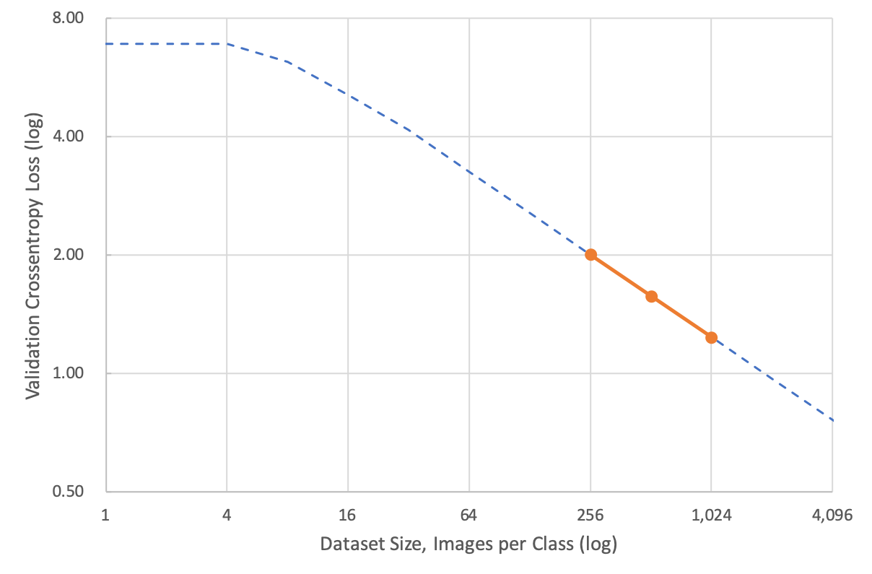
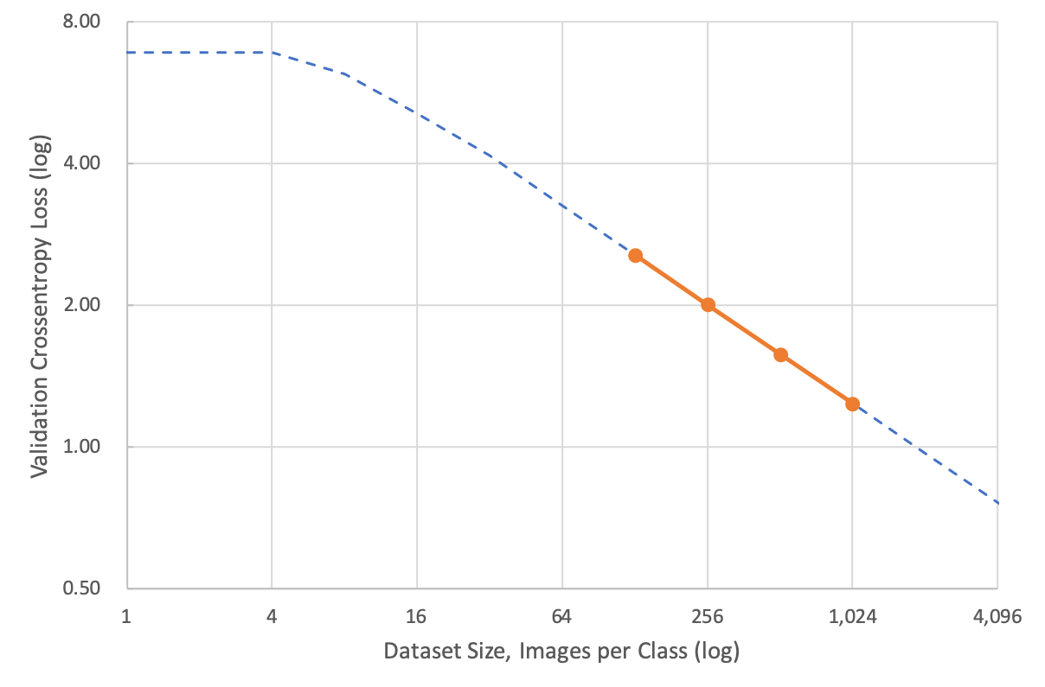
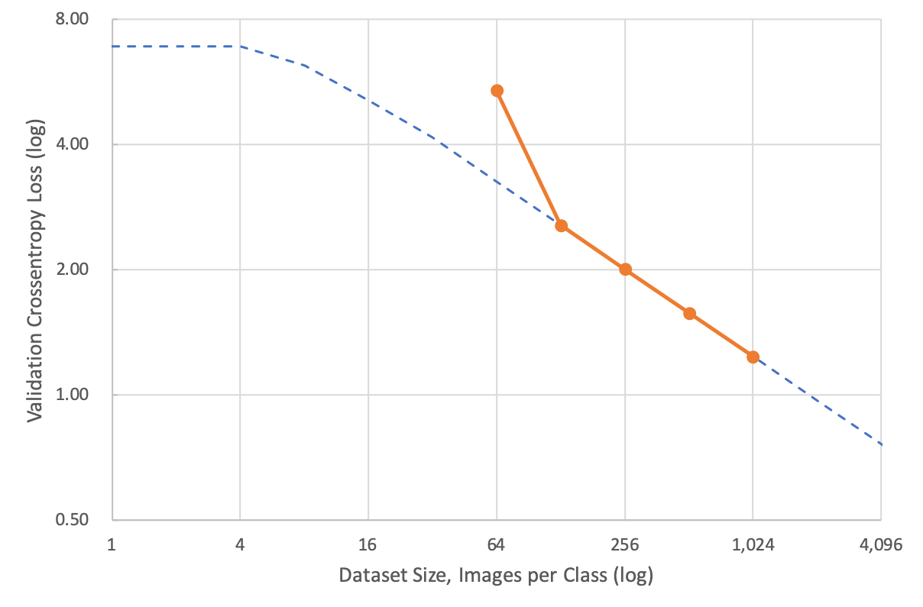
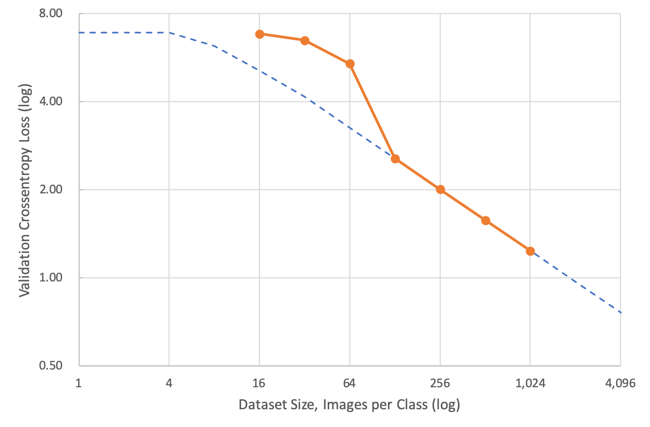
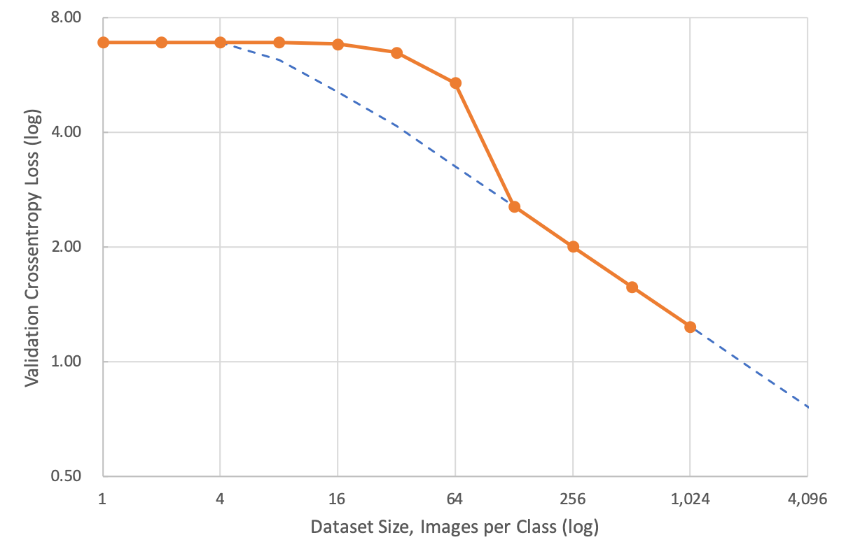
Image Classification: Small Data Challenges
Motivation:
Scale down data size
Iterate quickly on small data sets
As models begin to work, scale up!
WORK HERE!

Slide 72
Image Classification: Small Data Challenges
Decrease dataset size
Decrease model size
Everything else fixed
“Small-data gap”
Why?

Slide 73
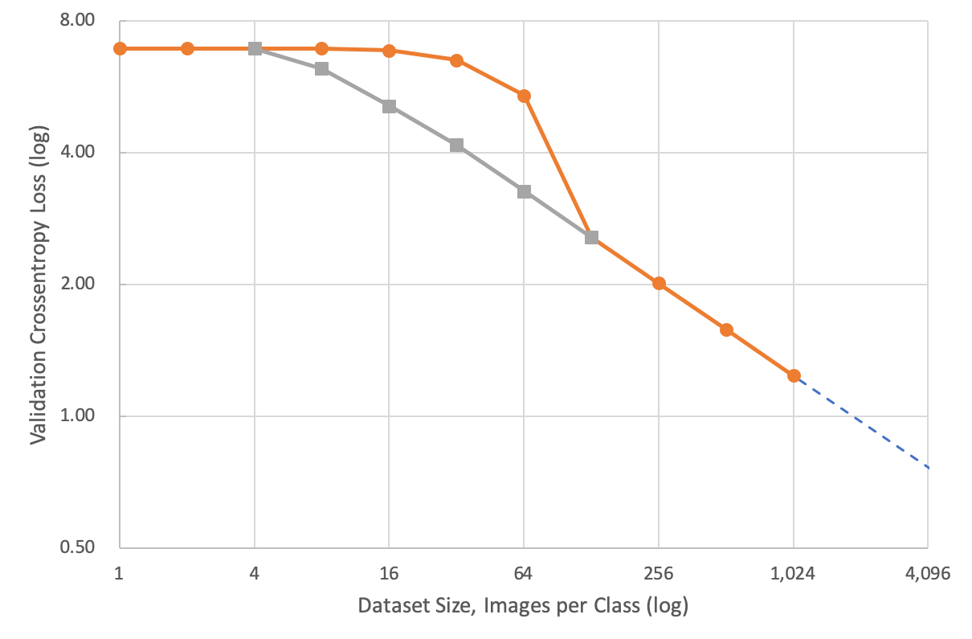
Image Classification: Small Data Challenges
Batch size too large
Small models have “lumpy” error surfaces
Large batch gradient average does more harm than good
Batch size can grow ~linearly with dataset size
Smith and Le, A Bayesian Perspective on Generalization and Stochastic Gradient Descent, https://arxiv.org/abs/1710.06451

