Slide 1
Cognitive Science and Neuroscience
Cognitive Science ~ Behavior
Neuroscience ~ Structure and Function
Unification
Requires good behavioral theories/models. Research on the physical basis of the ether or the life force did not work out well.

Slide 2
Cognitive Science and Neuroscience
Science is a reductionist enterprise - we look for explanations of phenomena at more basic levels. This does not entail "eliminative reduction" where only the lowest level has explanatory power. Theory, modelling, and experiment at multiple levels is important and these should be consistent. For Cognitive Science, the ancient formulation of knowledge as truth may be a serious barrier to understanding the mapping of thought to neurobiology and beyond.

Slide 3
Language as Logic
Yet every sentence is not a proposition; only such are propositions that have in them truth or falsity. Thus a prayer is a sentence, but it is neither true nor false. Let us therefore dismiss all other types of sentences but the proposition, for this last concerns our present inquiry, whereas the investigation of others belongs rather to the study of rhetoric or poetry.
Aristotle (De Interpretatione 17a1-8).

Slide 4
Functionalism
In fact, the belief that neurophysiology is even relevant to the functioning of the mind is just a hypothesis. Who knows if we’re looking at the right aspects of the brain at all. Maybe there are other aspects of the brain that nobody has even dreamt of looking at yet. That’s often happened in the history of science. When people say that the mental is just the neurophysiological at a higher level, they’re being radically unscientific. We know a lot about the mental from a scientific point of view. We have explanatory theories that account for a lot of things. The belief that neurophysiology is implicated in these things could be true, but we have very little evidence for it. So, it’s just a kind of hope; look around and you see neurons: maybe they’re implicated.
Noam Chomsky 1993, p.85

Slide 5
Embodiment
Of all of these fields, the learning of languages would be the most impressive, since it is the most human of these activities. This field, however, seems to depend rather too much on the sense organs and locomotion to be feasible.
Alan Turing (Intelligent Machines,1948)
< Continuity Principle of Darwin, American Pragmatists >

Slide 6
Substitution
“When faced with a difficult question, we often answer an easier one instead, usually without noticing the substitution,” writes psychologist and Nobel Prize winner Daniel Kahneman, in his new book.
If the question is “Should I invest in Ford Motor Company stock?” the easier question to answer is “Do I like Ford cars?”

Slide 7
Actionability
Observational learning without a model is influenced by the observer’s possibility to act: evidence from the Simon task
Cristina Iani, Sandro Rubichi, Luca Ferraro, Roberto Nicoletti, Vittorio Gallese Cognition 01/2013; 128(1):26-34.
“ the Simon effect is reduced, eliminated, or even reversed when participants perform a spatial compatibility task in which they are required to respond to a stimulus location by emitting a spatially incompatible response in advance”
“ Indeed no evidence of transfer of learning was found when, during passive observation, the participants’ hands were tied, or a transparent barrier prevented them from potentially interacting with the response device, or no response device was present. “

Slide 8
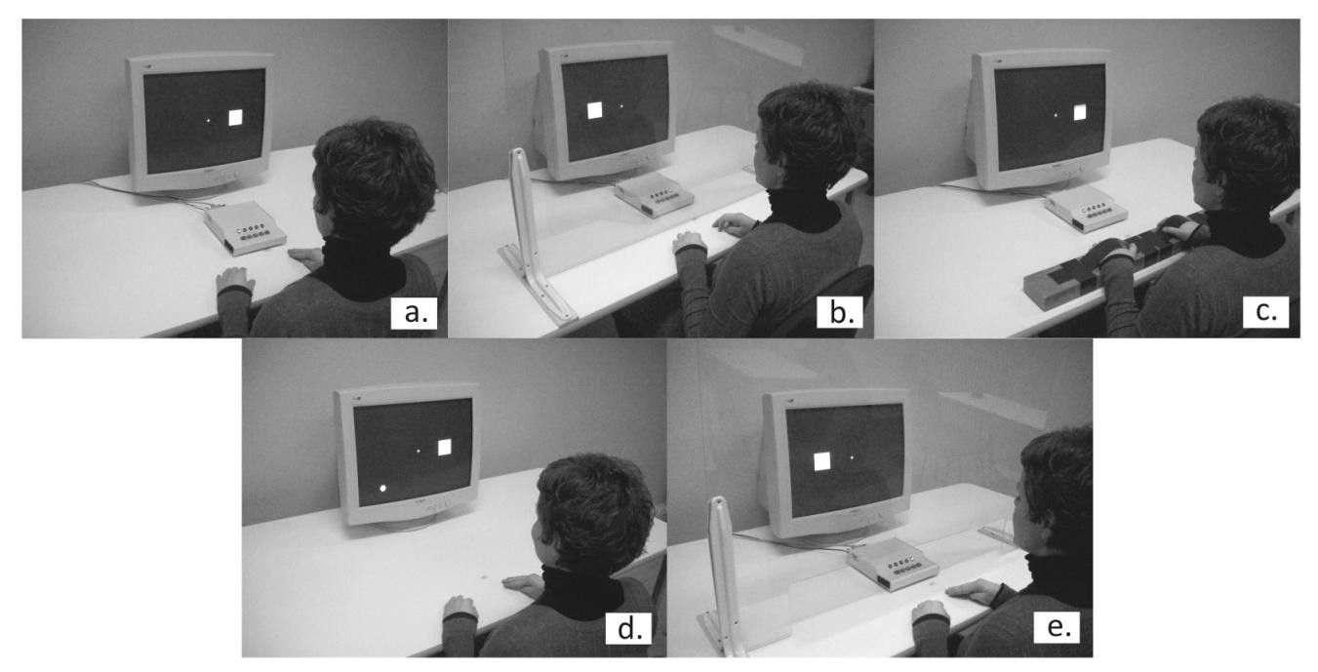
Figure 1. Illustration of the experimental setting used in the passive observational practice sessions of the three Experiments. In Experiment 1, the response box was positioned in front of the
participant (a.). In Experiment 2, in the “unreachable response device” condition, the response box was positioned behing a plexiglass barrier (b.), in the “constrained hands” condition, participant’s hands were tied to the table (c.), and in the “response device absent” condition, the response box was absent (d.). In Experiment 3, the plexiglass barrier presented an horizontal opening (e.).

Slide 9
Actionability, Simulation and Unified Cognitive Science
1) Action is evolutionarily much older than symbolic thought, belief, etc.; also developmentally earlier
2) Only living things act (in our sense); natural forces, mechanisms act by metaphorical extension.
3) Fitness is nature’s assessment of actions; we define actionability as an organism’s internal
assessment of its available actions in context.
4) Actionability, not non-tautological truth, is what an agent/animal can actually compute.
5) Communication is action and is needed for cooperation – from pheromones to language
6) Actions include persistent change of internal state: self-concept, memory, world models, learning, etc.
The external world (e.g., other agents) is not static - internal models need simulation
7) The brain is not a set of areas that represent things, rather a network of circuits that do things.
8) In animals, perception is best-fit, active, and utility/affordance based.
9) Mysteries remain; subjective experience, binding, self, free will, robots, etc.
10) One crucial divide/cline is volitional action and communication – boundary not clear, but birds are
above the line; protozoans, plants below. Assume, in nature, neurons are necessary for volition. 11) Volitional actions have automatic components and influence, e.g., speech
12) Cognitive Science is bounded by [neurons, individuals]; unify with related sciences.
13) Overall goal of the effort is consistency with all experimental findings.
14) Theory remains central; multiple formalisms are needed – theories should cohere
Control, probability, computation, logic, dynamics, utility, process, system, learning,
15) Formulation is multi-level in three ways:
Standard divisions by scale, complexity - synapse, neuron, circuit, etc.
System formulation – whole and parts inseparable, body-environment coupling essential
Higher level sciences describe the phenomena, e.g., linguistics, psychology.
16) Action models are multi-modal: describe execution, recognition, planning, language.
17) Volitional simulation proposed as the mechanism of planning, mind-reading, etc. With an
appropriate formalism, simulation can yield both causal and predictive inferences.
18) Biological, social, and cultural co-evolution, including language.
19) Linguistics based on embodied simulation semantics as the foundation of language and thought.
20) Additional mechanisms include construction grammar, mental spaces, mappings, etc.
21) Rationalization and other mental illusions

Slide 10
Actionability in Integrated Cognitive Science
1. All living things act; acting is what living things do.
2. Natural selection constrains the fitness (utility) of these actions.
3. Volition is the key concept; agents perform volitional as well as automatic actions.
4. Actionability is an agent's assessment of the expected utility of an external or internal action.
5. This defines, but does claim to solve, actionability as a integrating issue for Cognitive Science.
6. No answers are suggested for hard mind-brain problems like subjective agency.
7. Actionability calculation often involves simulation of action and its consequences.

Slide 11
Brains ~ Computers
▪ 1000 operations/sec
▪ 100,000,000,000 units
▪ 10,000 connections/
▪ graded, stochastic
▪ embodied
▪ fault tolerant
▪ evolves, learns
▪ 1,000,000,000 ops/sec
▪ 1-100 processors
▪ ~ 4 connections
▪ binary, deterministic
▪ abstract
▪ crashes
▪ designed, programmed
100 Step rule: Reaction times ~ 100 milliseconds

Slide 12
Variable Binding
Variable Binding ~ Neural Reasoning
In behavior
Grasping motion depends on object to grasp
Drive away in a rental car
In inference, language
Human(x) -> Mortal(x)
Must bind a variable to x
Unification : *One cows, one/two sheep
Pronouns, Antecedents: He moved her hand

Slide 13
Proposals for Neural Binding
Brute-force enumeration ~ crossbars
Does not scale to human knowledge, variability
No learning model
Signature propagation (direct reference)
Implausible to pass enough information to directly reference each item (~ 20 bits)
Unifying bindings (e.g. agreement) is difficult
Temporal synchrony (e.g.SHRUTI)
Weak biological evidence, unification unsolved
Hummel JE (2011) Getting symbols out of a neural architecture. Connection Science 23:109-118

Slide 14
